Slide 1




Unfolding the Atmospheric Muon Flux with IceCube Pascal Gutjahr
wiki page
CRWG: Dennis
Collab: Anatoli
Tech: Karolin
IceCube Meeting Utah
October 7, 2025
Source: NASA

Slide 2


Introduction
Motivation
Characterize muon flux components and depth intensity
Probe hadronic interactions in the atmosphere
Constrain uncertainties and longstanding questions like the “muon puzzle”
Long term
Enhance understanding of hadronic processes relevant in distant astrophysical sources (e.g., supernovae, AGNs, …)
$φ_{tot}=φ_{prompt}+$ $φ_{conventional}$
Conventional Muon:
Parent is pion or kaon
Credit: Ludwig Neste

Slide 3
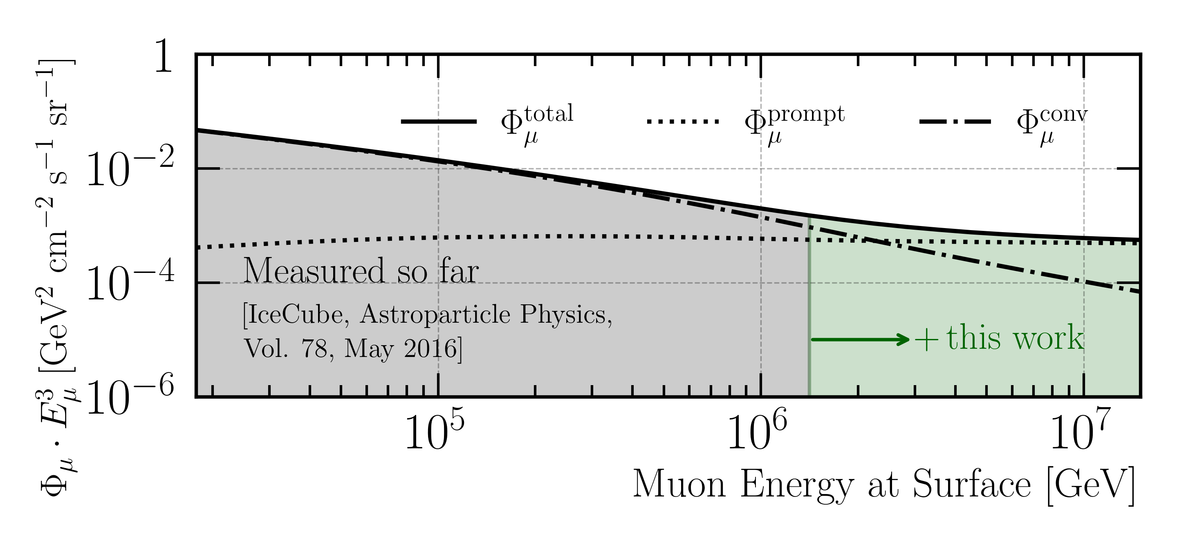
Goal: Measure Muon Flux at Surface
MCEq: SIBYLL 2.3d (H3a)

Slide 4
Overview
Simulation
Reconstruction
Selection
Unfolding
Dataset
CORSIKA 77500 Ehist
SIBYLL 2.3d
10 TeV – 100 EeV
Snowstorm
DNN reconstructions
Muon energies
Muon direction
Track geometry
Level 3
L2 muon filter
Add labels
Muon spectrum
Unfold muon flux at surface
Level 4
500 TeV bundle energy cut at surface
Add DNN reconstructions
Validation
Tag prompt / conv particles
MCEq comparisons
Level 5
Data-MC quality cuts
Final Level
Leadingness cut

Slide 5
New CORSIKA simulation
with extended history option for information about the parent particles
6 Datasets: 22875, 22774—8
Primary Energy: 600 GeV – 1e11 GeV

Slide 6
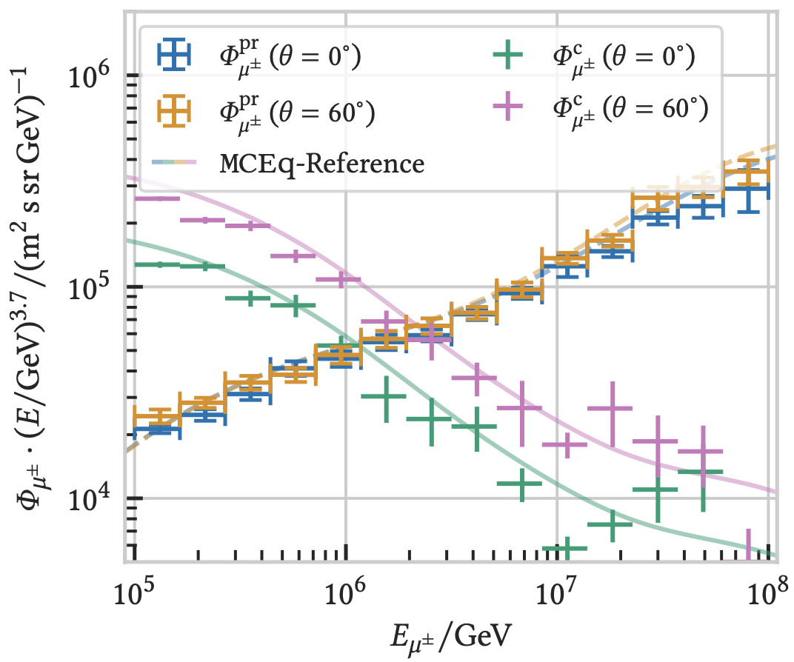

CORSIKA 7 vs. MCEq
MCEq: tool to numerically solve the cascade equations that describes the evolution of particle densities as they propagate through a gaseous, dense medium
https://github.com/mceq-project/MCEq
Good agreement for inclusive flux
Python package developed – PANAMA
Execute CORSIKA 7 (multi core)
Read DAT files → pandas DataFrames
Parse EHIST option
Calculate primary weightings
https://github.com/The-Ludwig/PANAMA
Neste & Gutjahr et al., EPJ C, 85, 759 (2025)

Slide 7
Reconstruction
Machine Learning (CNN)

Slide 8
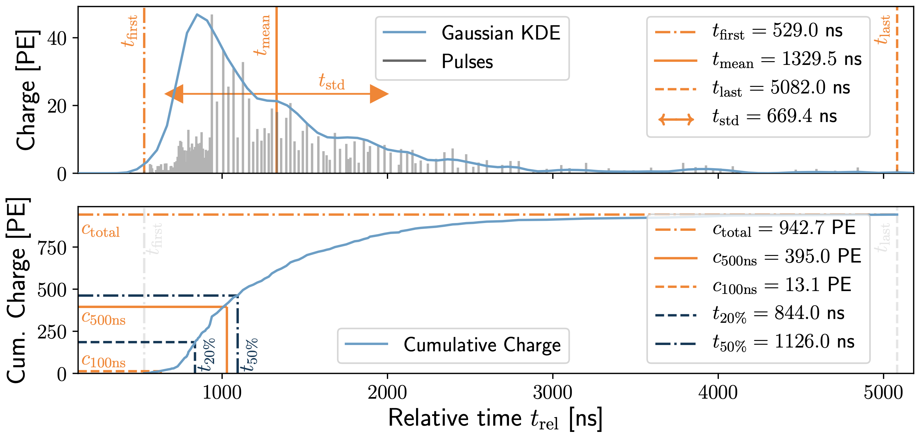
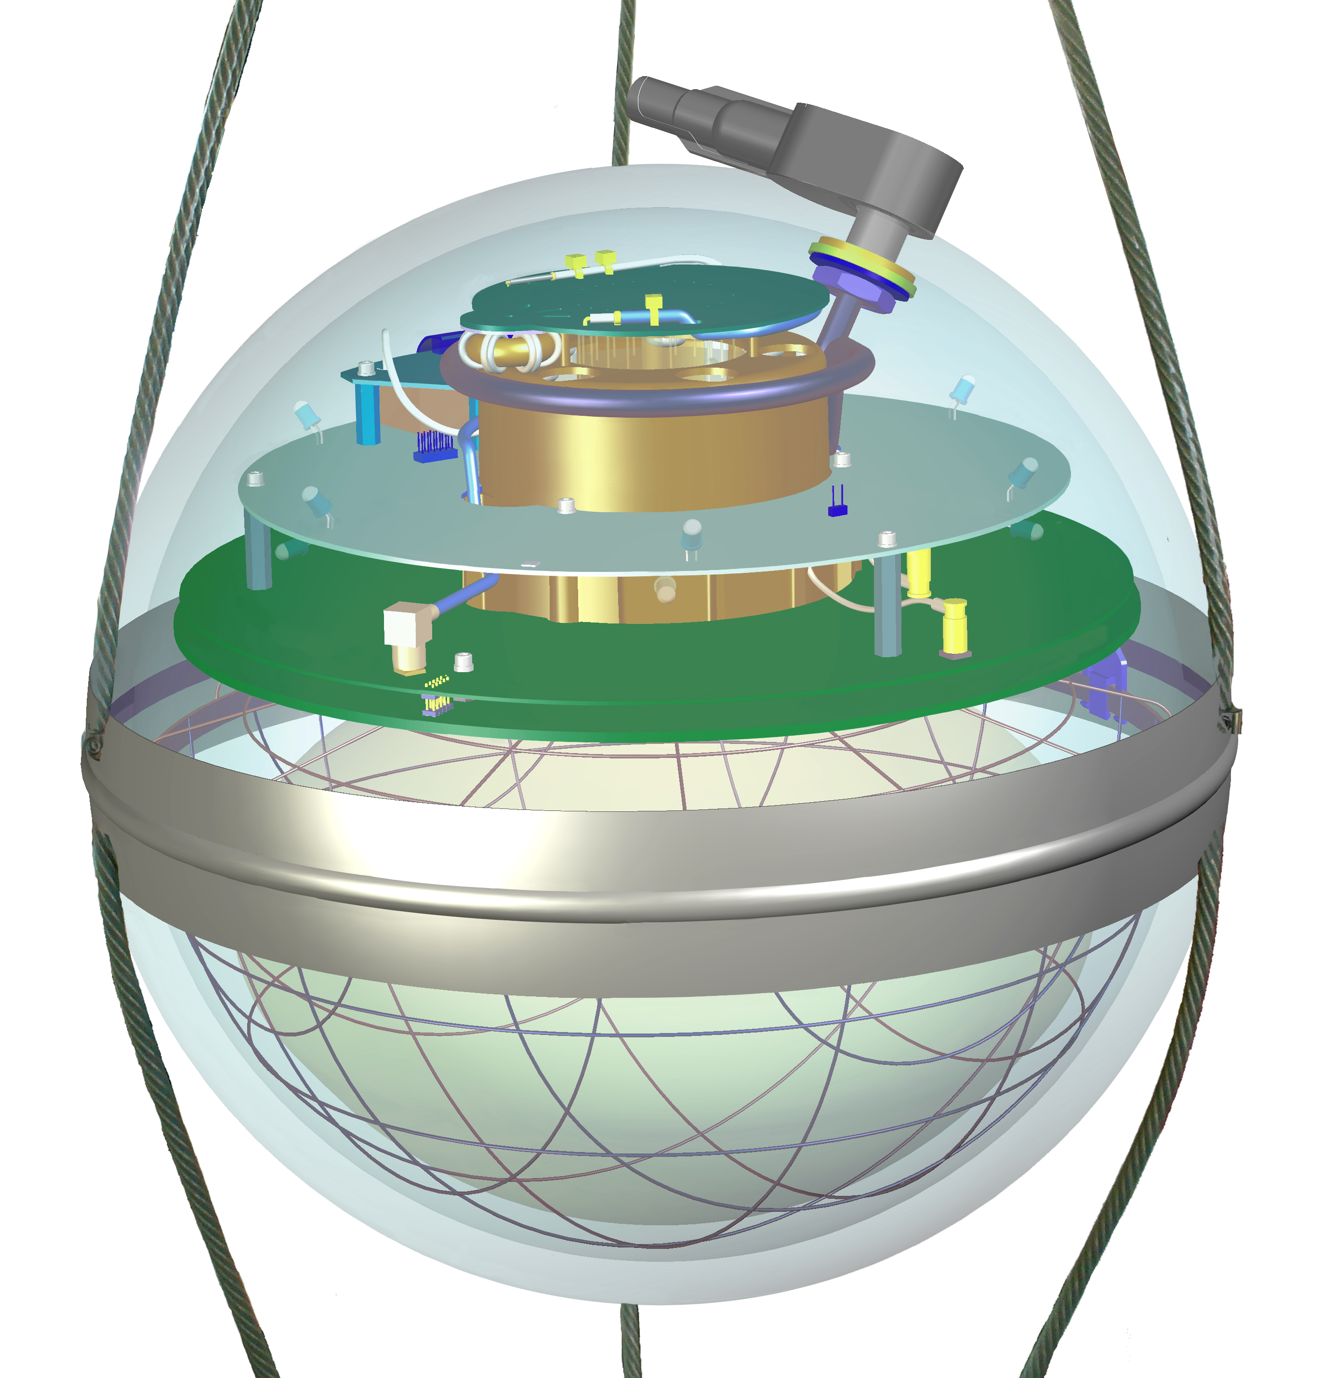
Input data per DOM
10.1088/1748-0221/16/07/P07041
3 inputs
c_{total}: Total charge
Sum of charge
t_{first}: Relative time of first pulse
Relative to total time offset, calculated as the charge weighted mean time of all pulses
t_{std}: Standard deviation of first pulse
Charge weighted standard deviation of pulse times relative to total time offset
9 inputs
t_{last}: Relative time of last pulse
Relative to total time offset, calculated as the charge weighted mean time of all pulses
t_{20%}: Relative time of 20% charge
Relative to total time offset, calculated as the charge weighted mean time of all pulses
t_{50%}: Relative time of 50% charge
Relative to total time offset, calculated as the charge weighted mean time of all pulses
t_{mean}: Mean time
Charge weighted mean time of all pulses relative to total time offset
c_{500ns}: Charge at 500ns
Sum of charge after 500ns
c_{100ns}: Charge at 100ns
Sum of charge after 100ns
Input pulse cleaning
6000 ns
Training data
Different simulations for robustness
Credit: IceCube

Slide 9
Reconstructed properties
Energy
entry_energy: Leading muon energy at the detector entry
bundle_energy_at_entry: Muon bundle energy at the detector entry
muon_energy_first_mctree: Leading muon energy at surface
bundle_energy_in_mctree: Muon bundle energy at surface
Track geometry
Length: Propagation length of muon in the ice
LengthInDetector: Propagation length of muon in the detector
center_pos_x: Closest x position of muon to center of the detector
center_pos_y: Closest y position of muon to center of the detector
center_pos_z: Closest z position of muon to center of the detector
center_pos_t: Time of closest approach to the center of the detector
entry_pos_x: x position of muon at the detector entry
entry_pos_y: y position of muon at the detector entry
entry_pos_z: z position of muon at the detector entry
entry_pos_t: Time of muon at the detector entry
Direction
zenith: Zenith angle of muon
azimuth: Azimuth angle of muon
Network 1
Network 0: Muon bundle energy at surface (fast pre-cut)
Network 2
Network 3

Slide 10
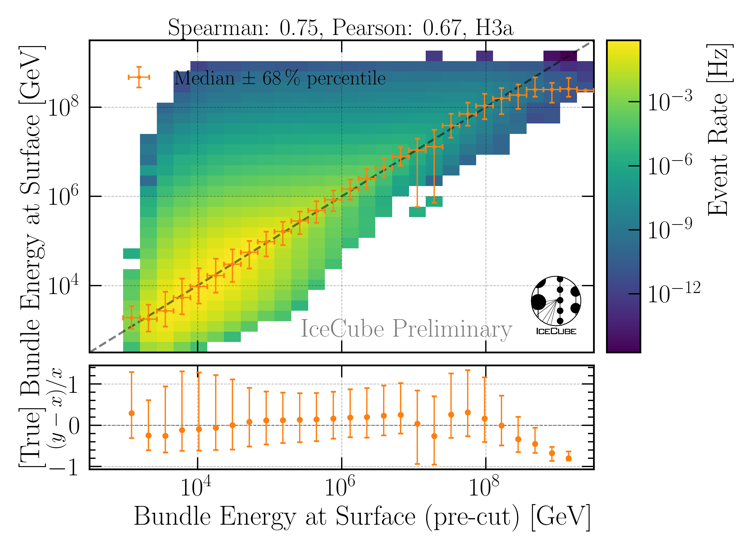
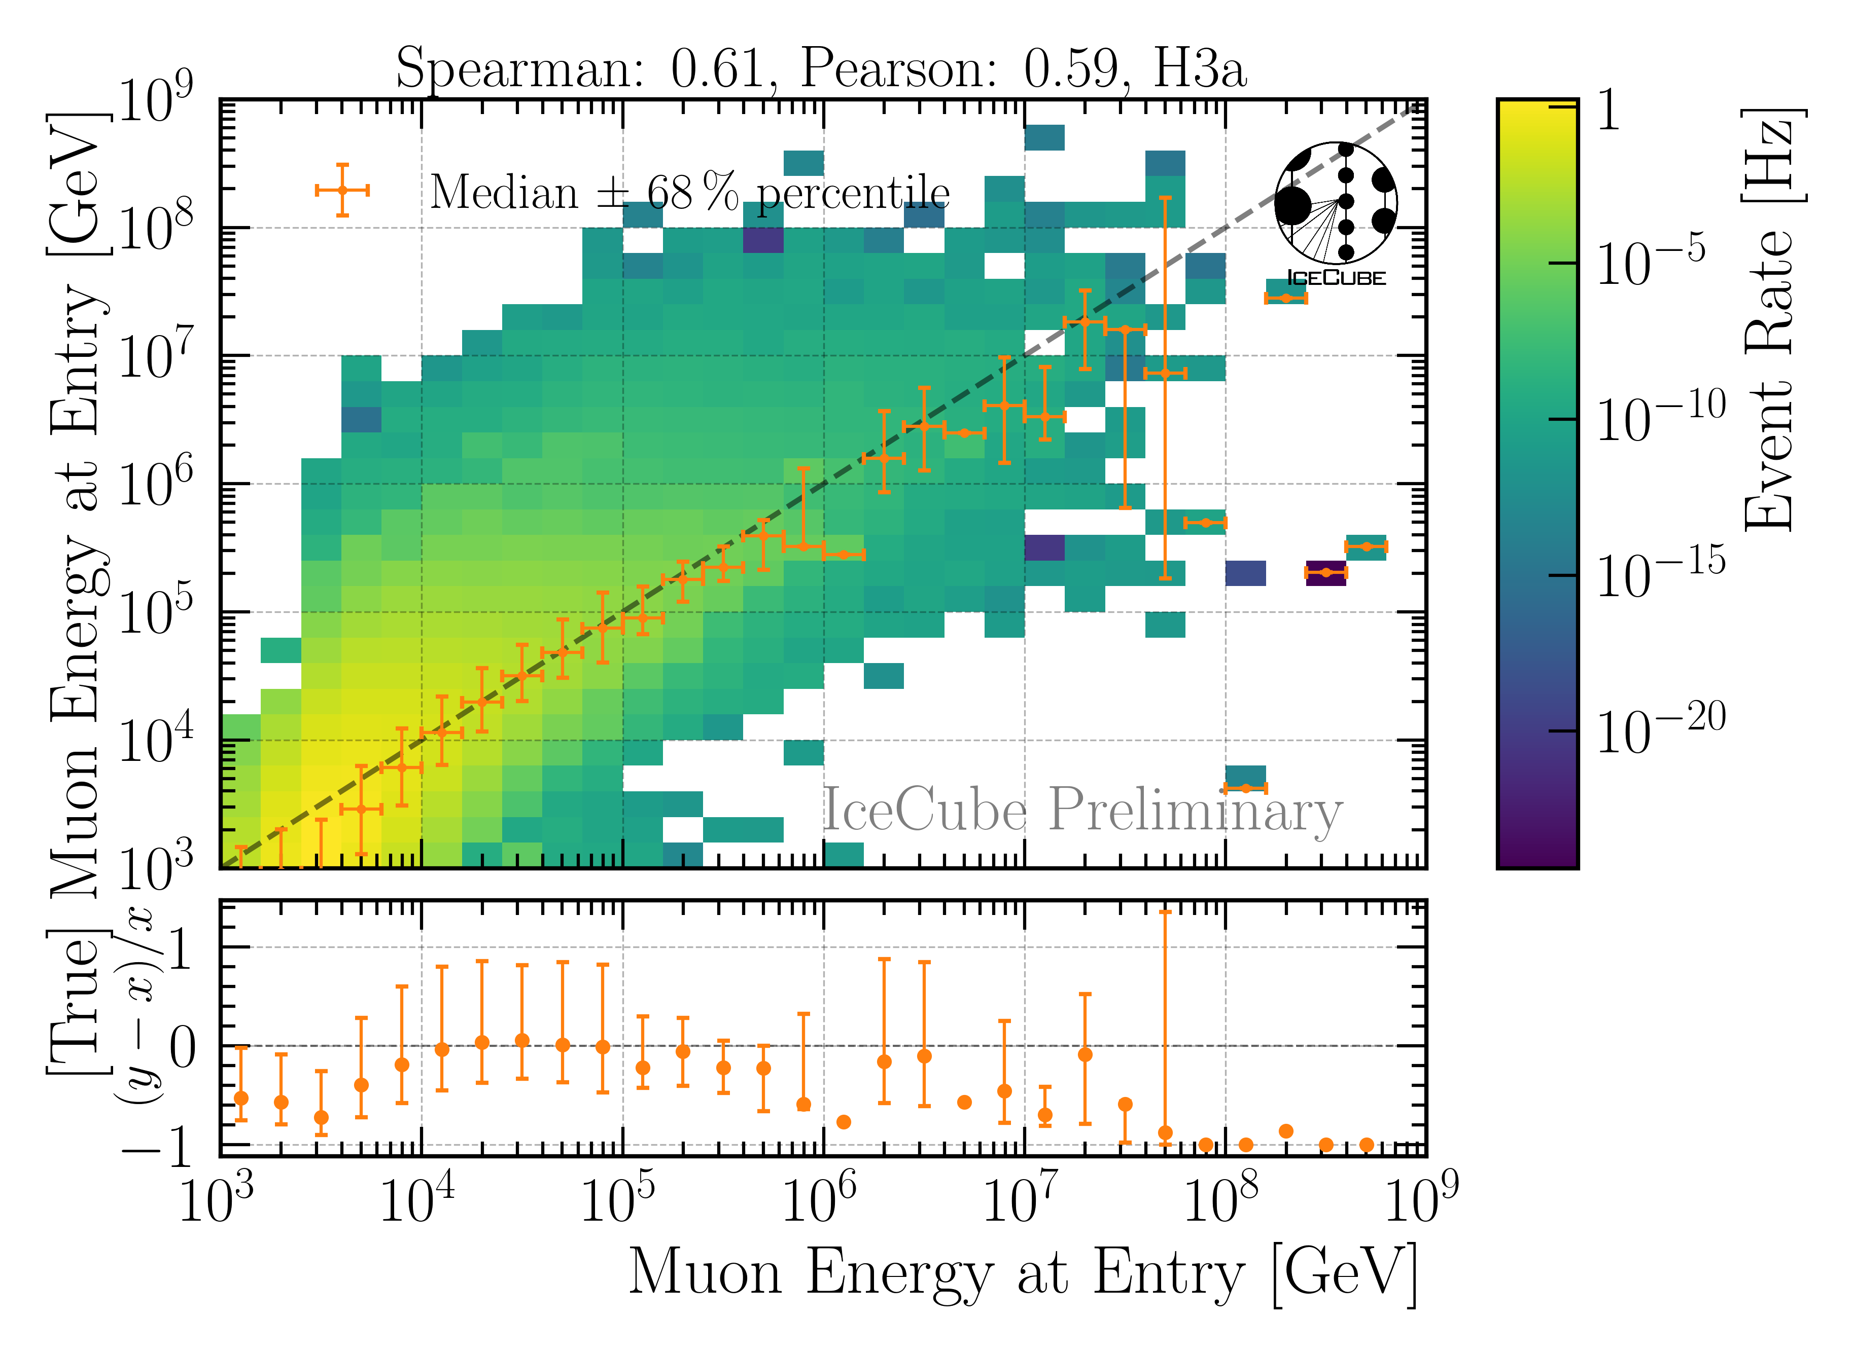
Energy Reconstructions
performed on Level 3 (explained later)
Sufficient energy reconstructions
Tight 68 % intervals, with outliers

Slide 11
Selection

Slide 12
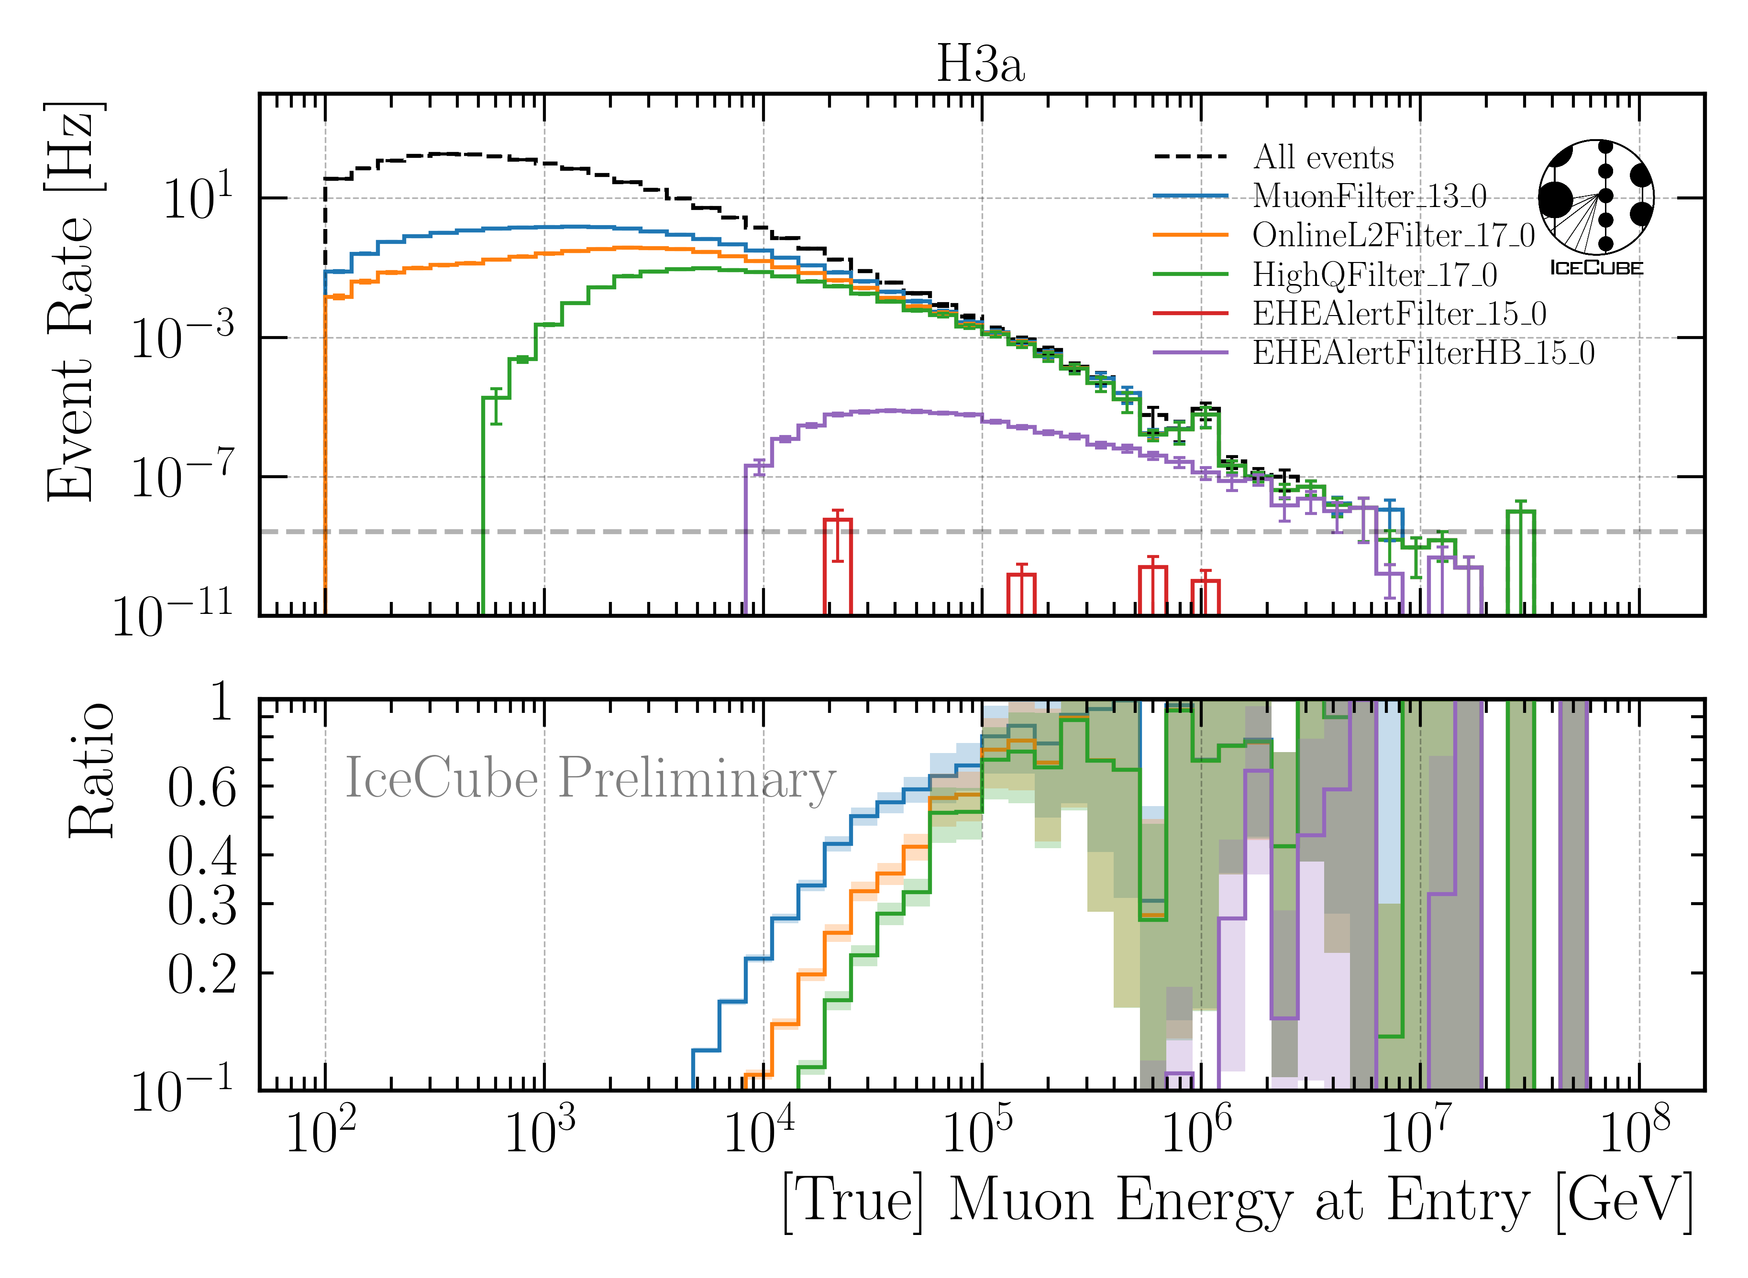
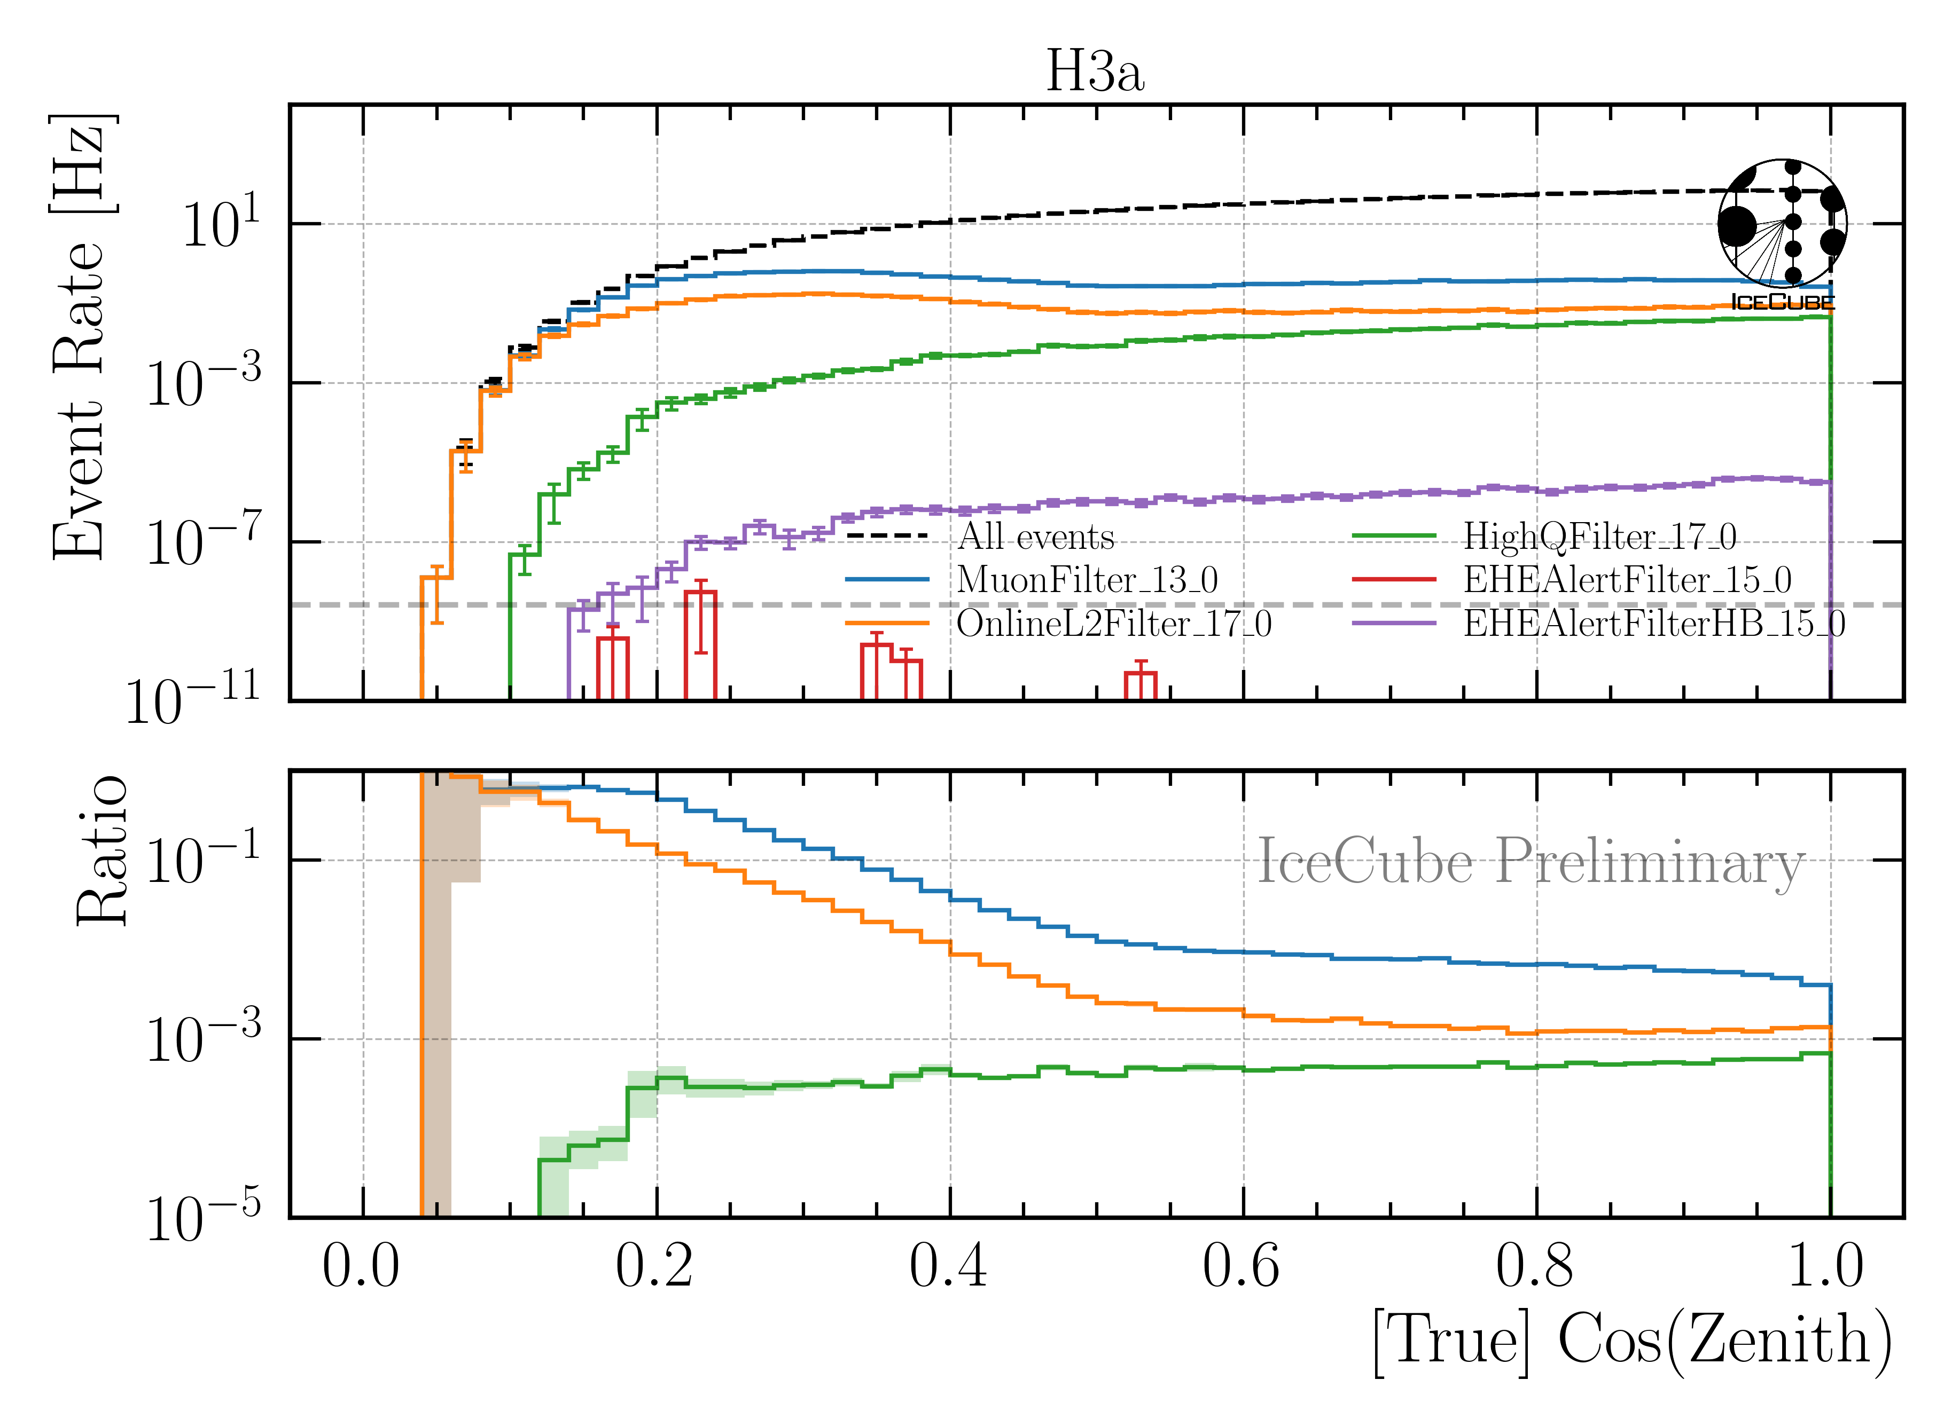
Level 3: Muon Filter
Muon filter: zenith-dependent charge and quality cut
Choose muon filter to select as many high-energy muons as possible

Slide 13
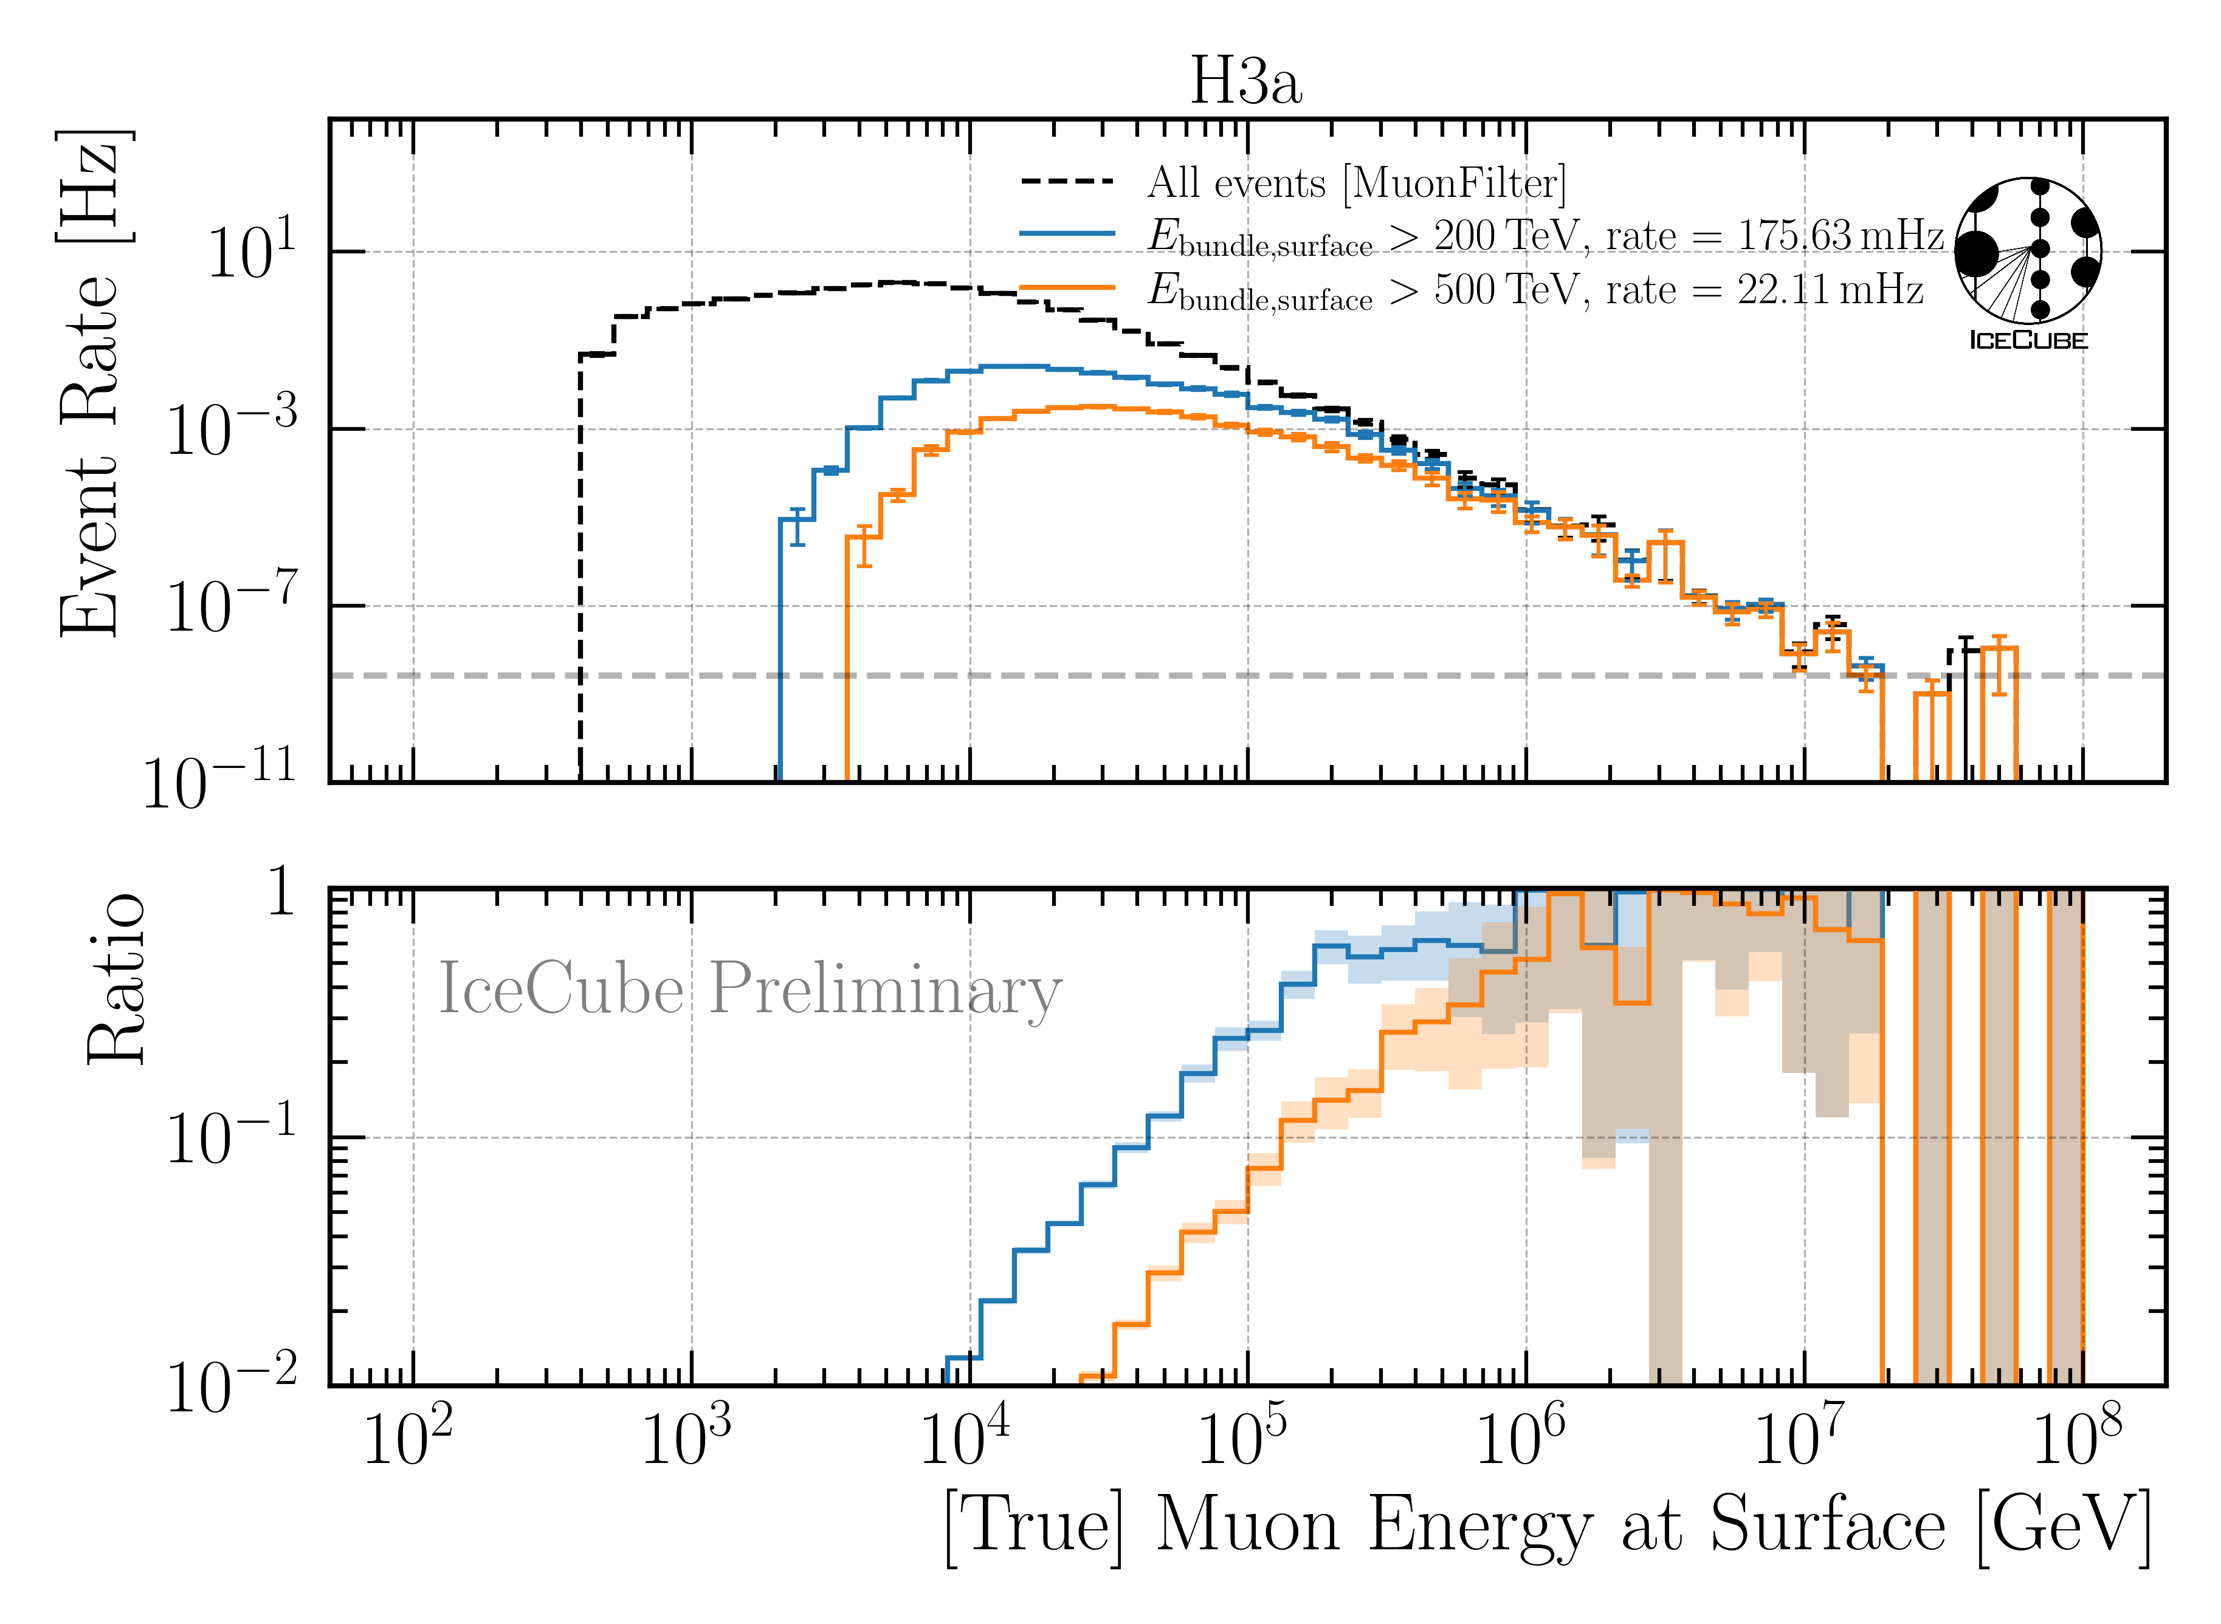
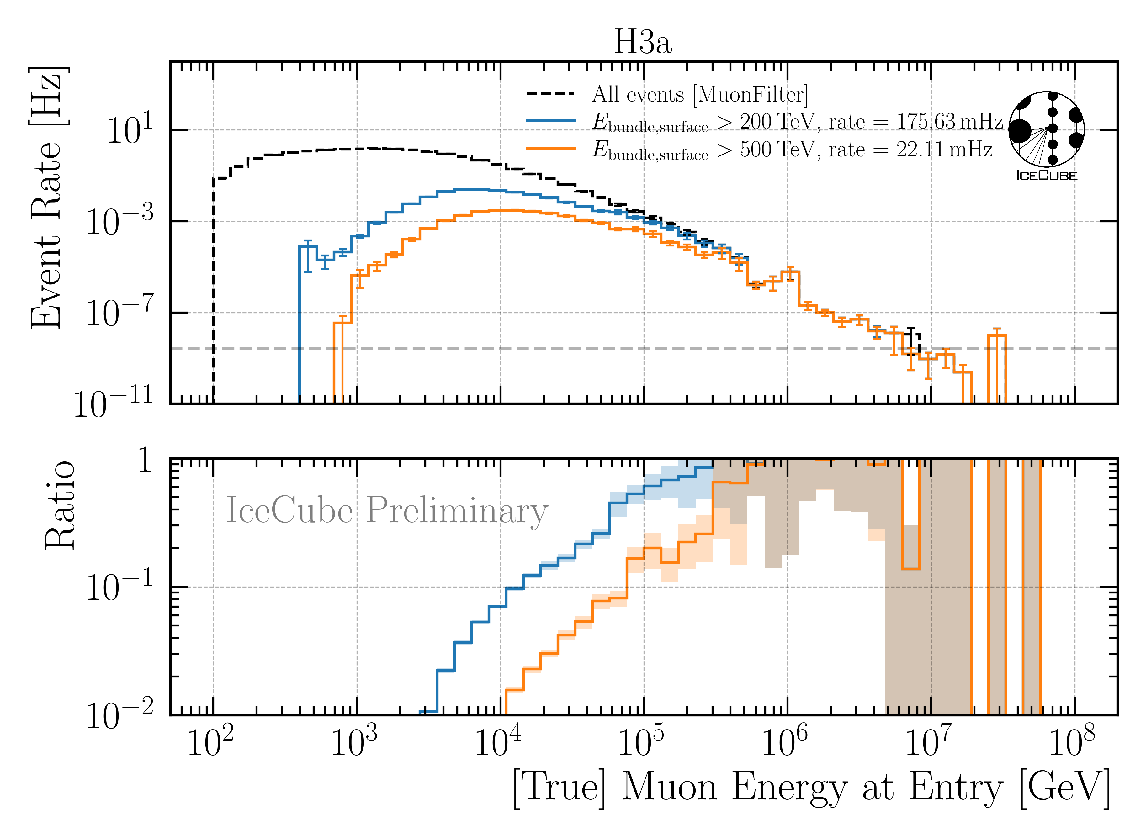
Level 4: Energy Cut
6 billion events expected in 10 years → computationally not feasible
focus on high-energetic events
Remove low-energy muons: bundle energy at surface > 500 TeV

Slide 14
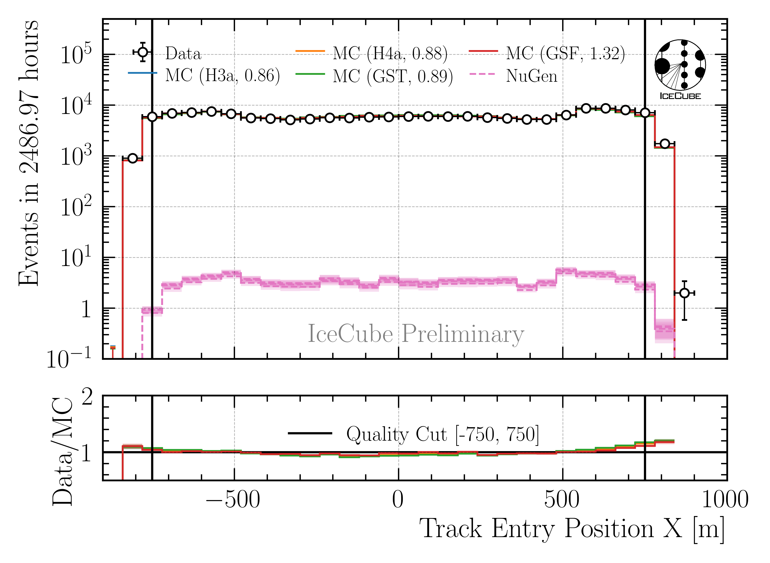
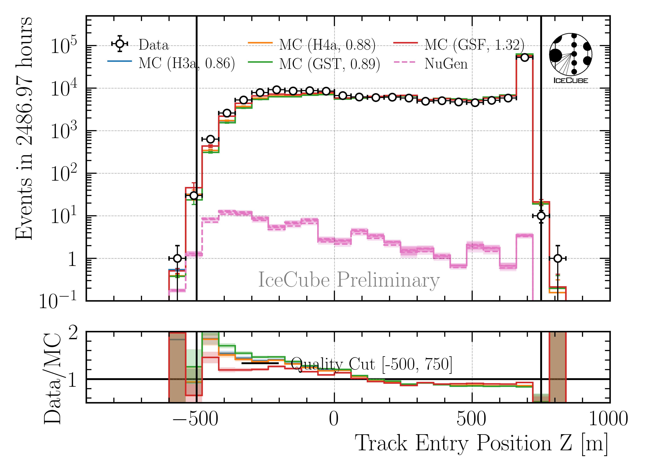
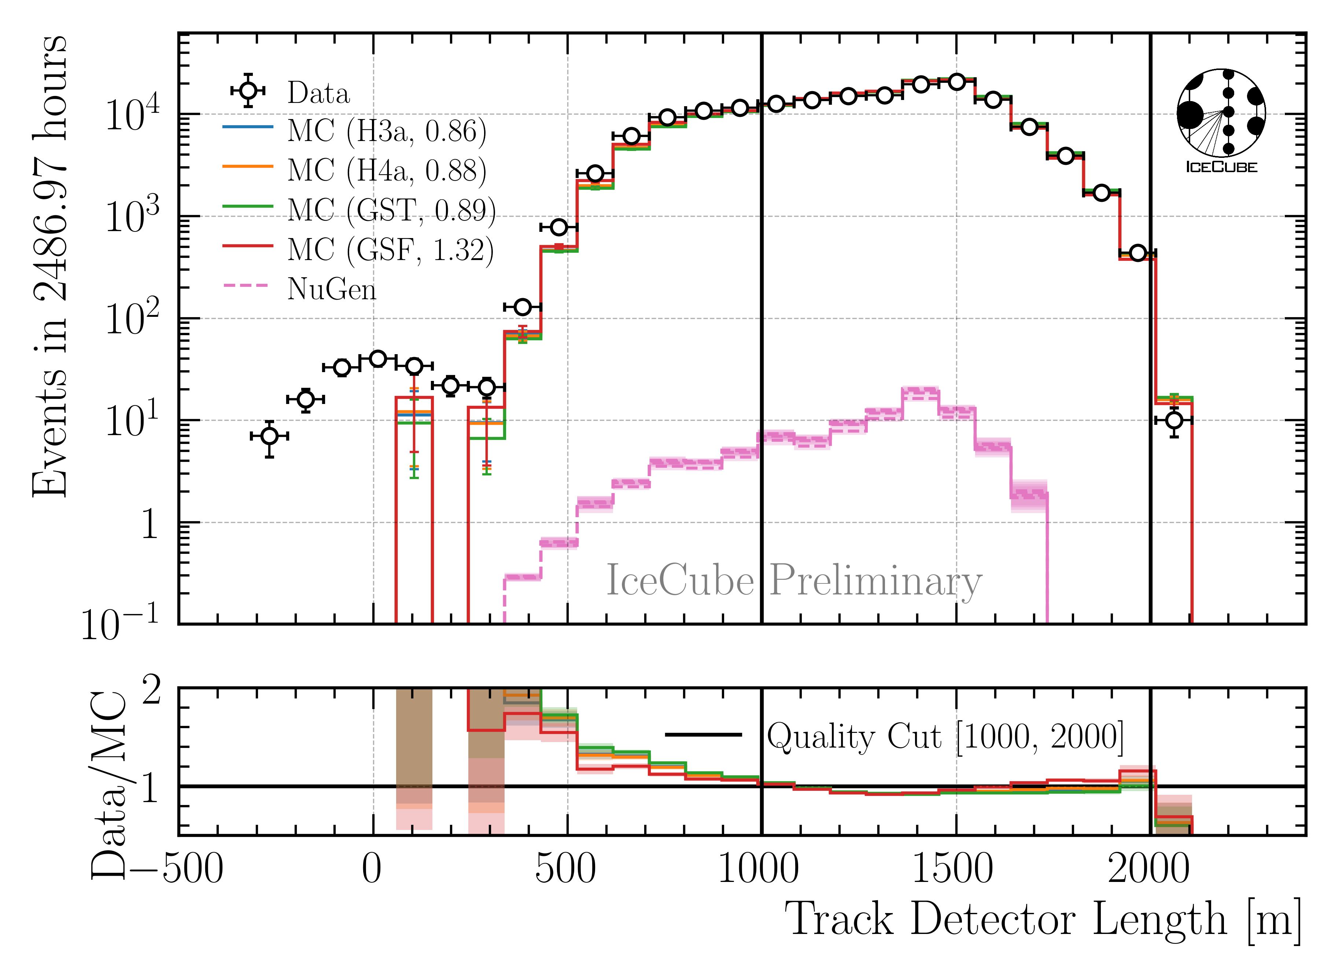
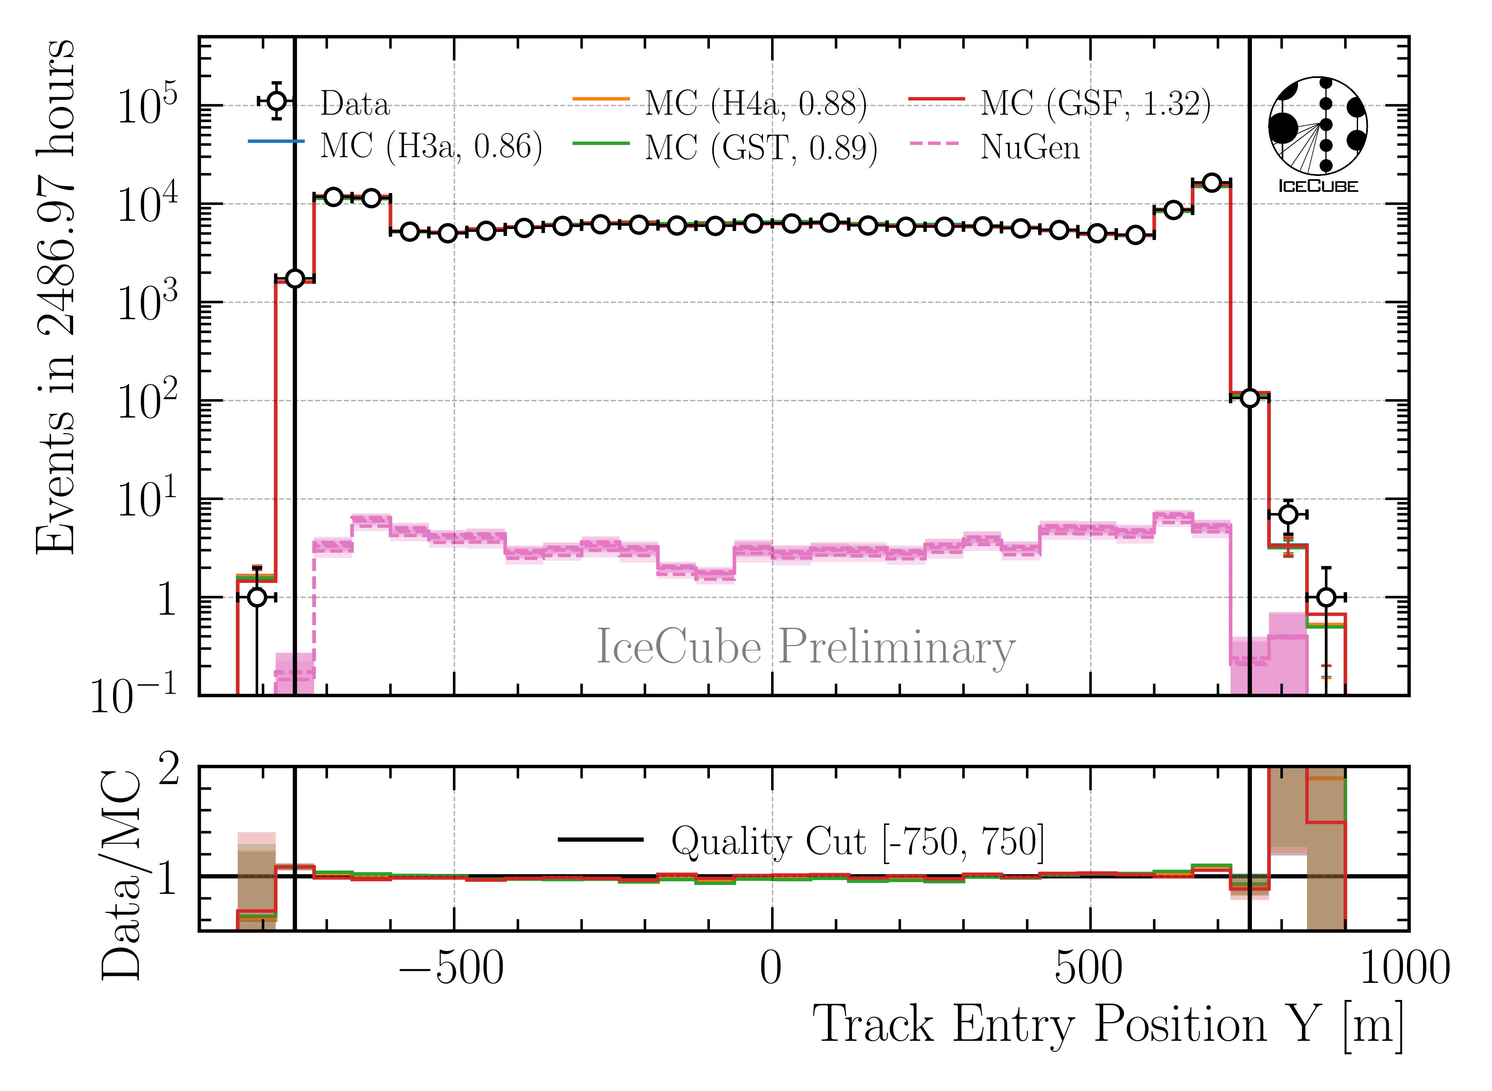
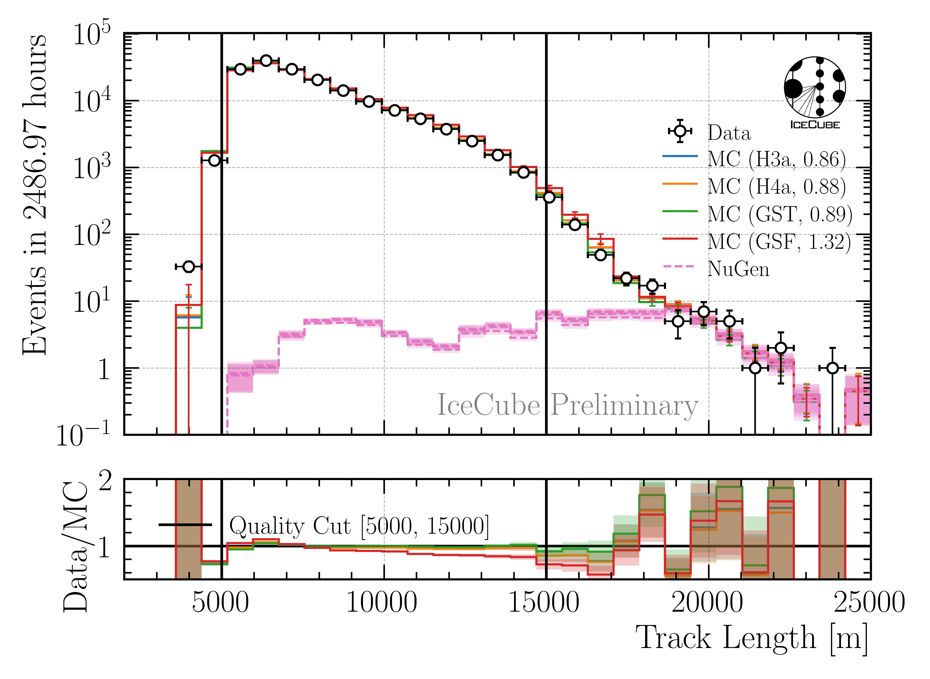
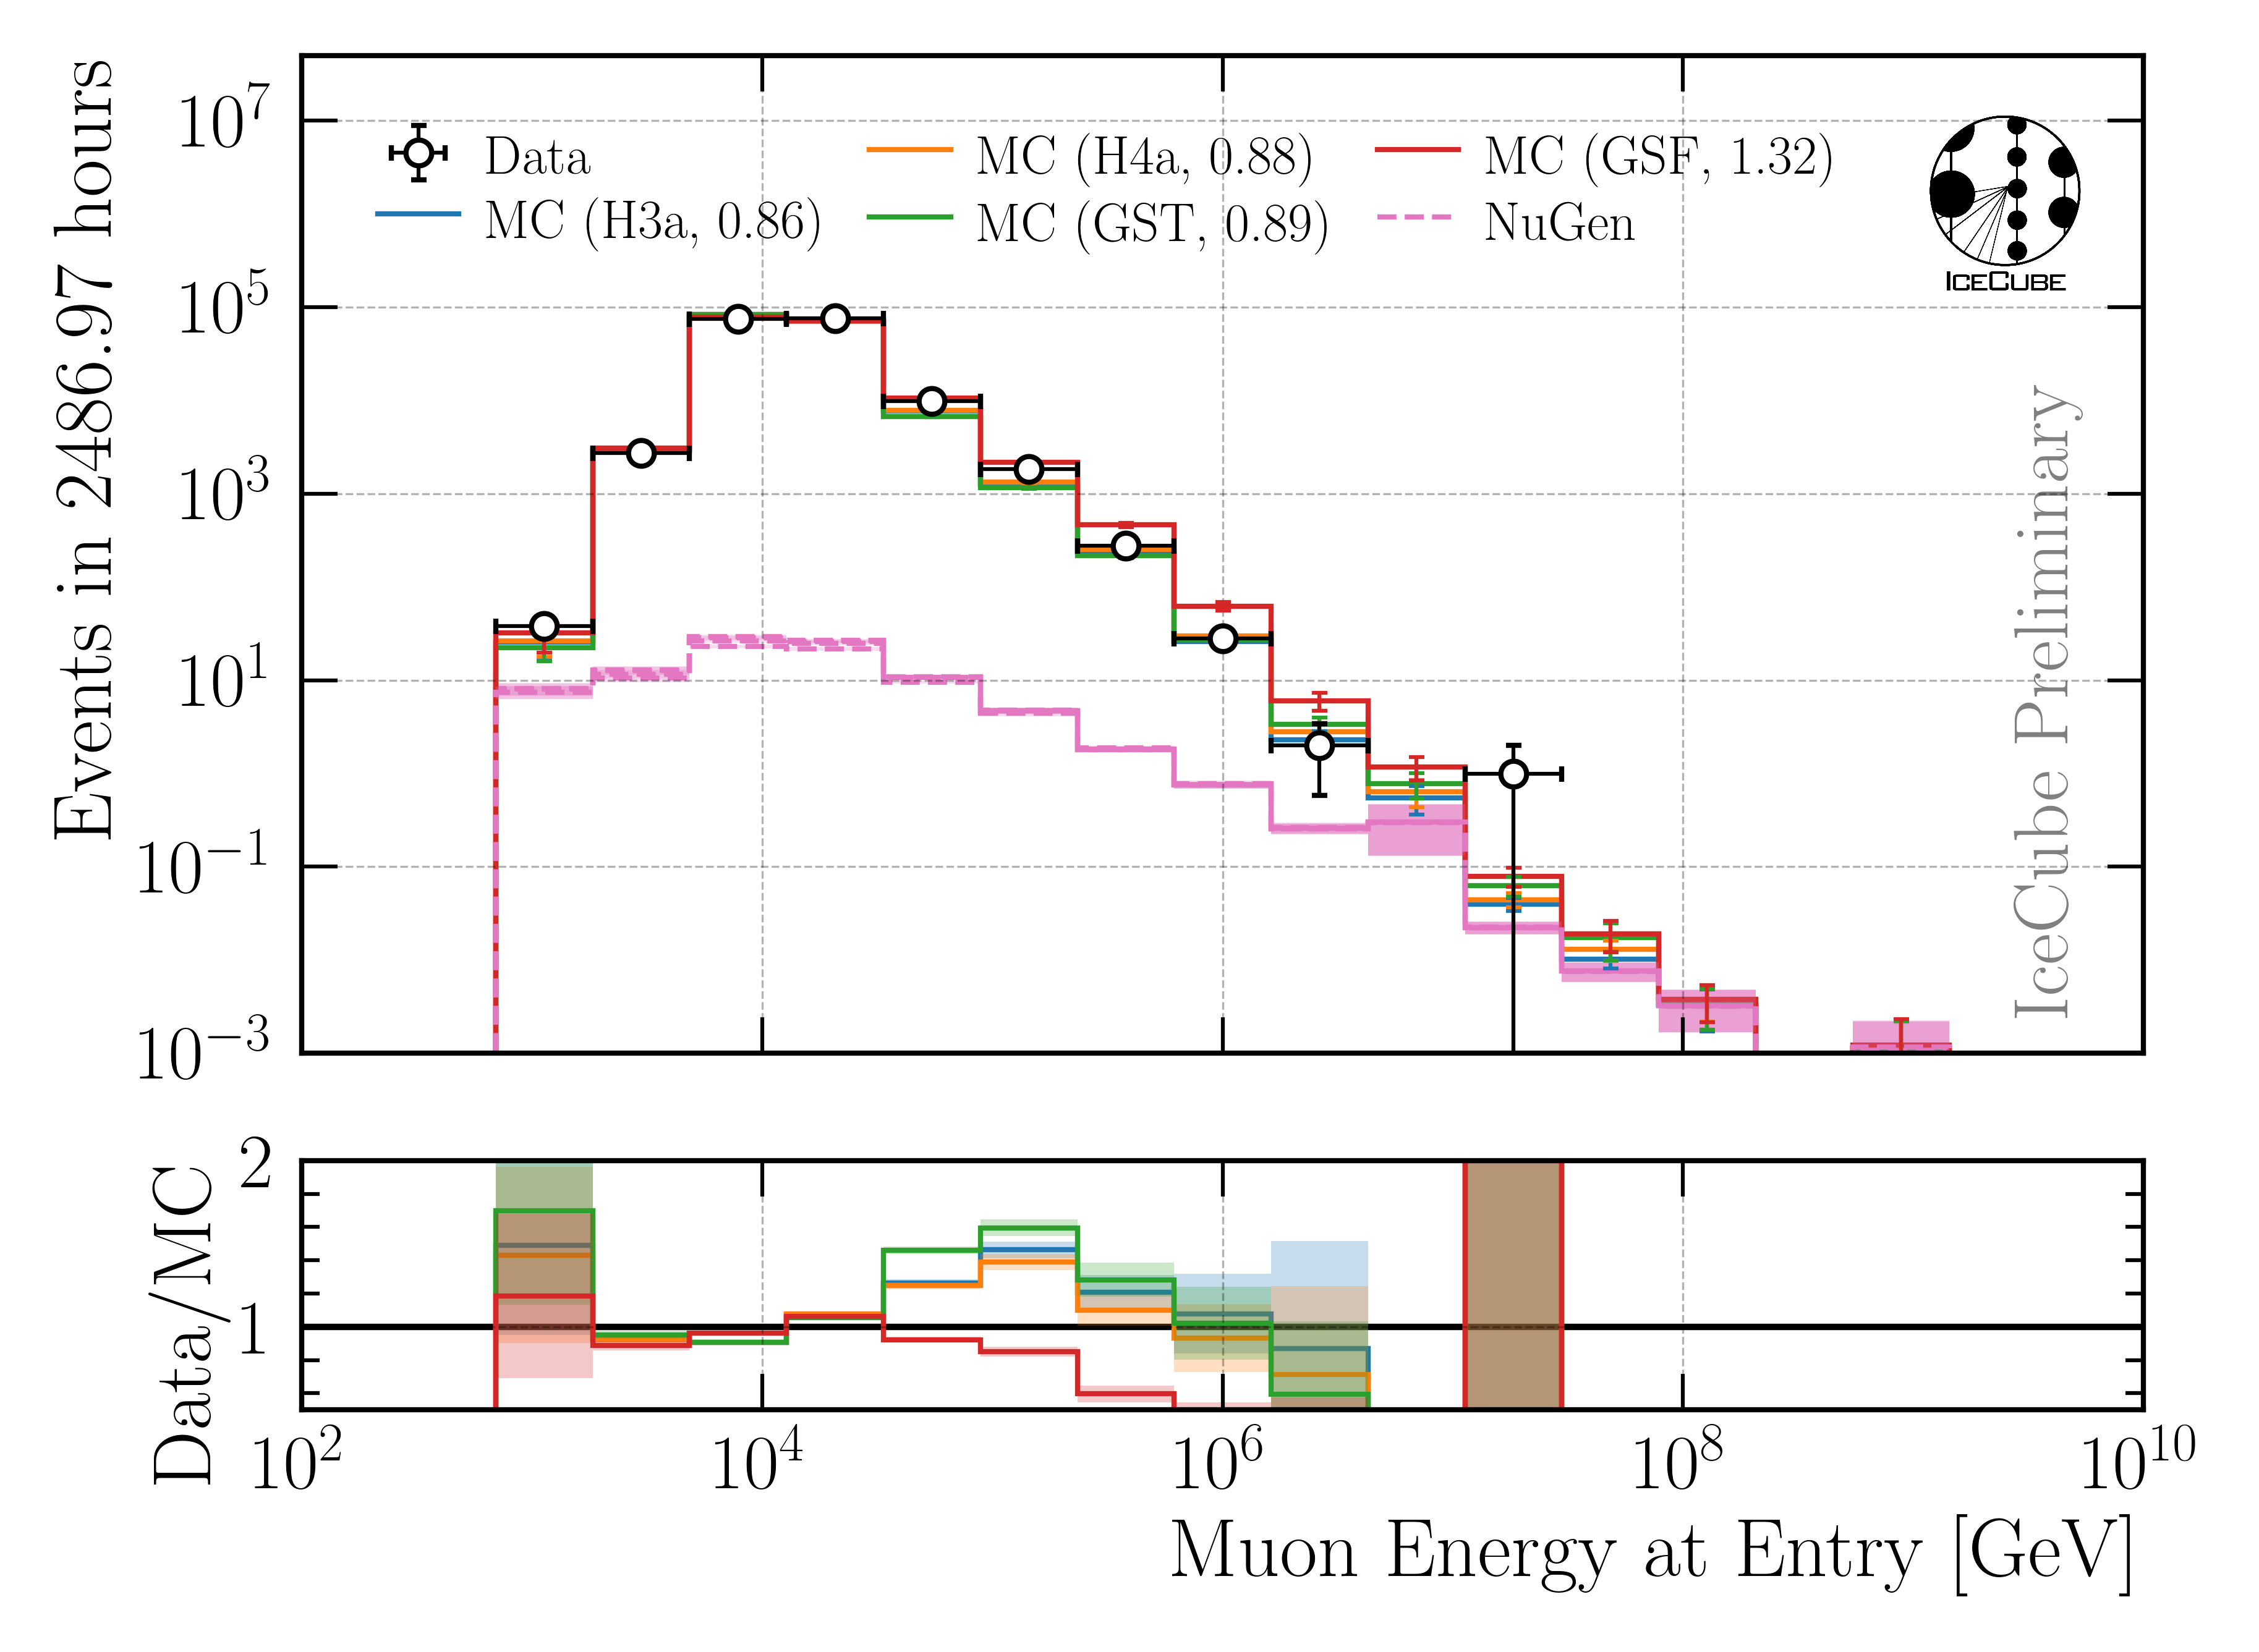
Level 5: Data/MC Quality Cuts
Remove outliers
Depth—dependent slope (no analysis relevance)
CR—model impact on energy reconstruction
23 quality cuts in total

Slide 15
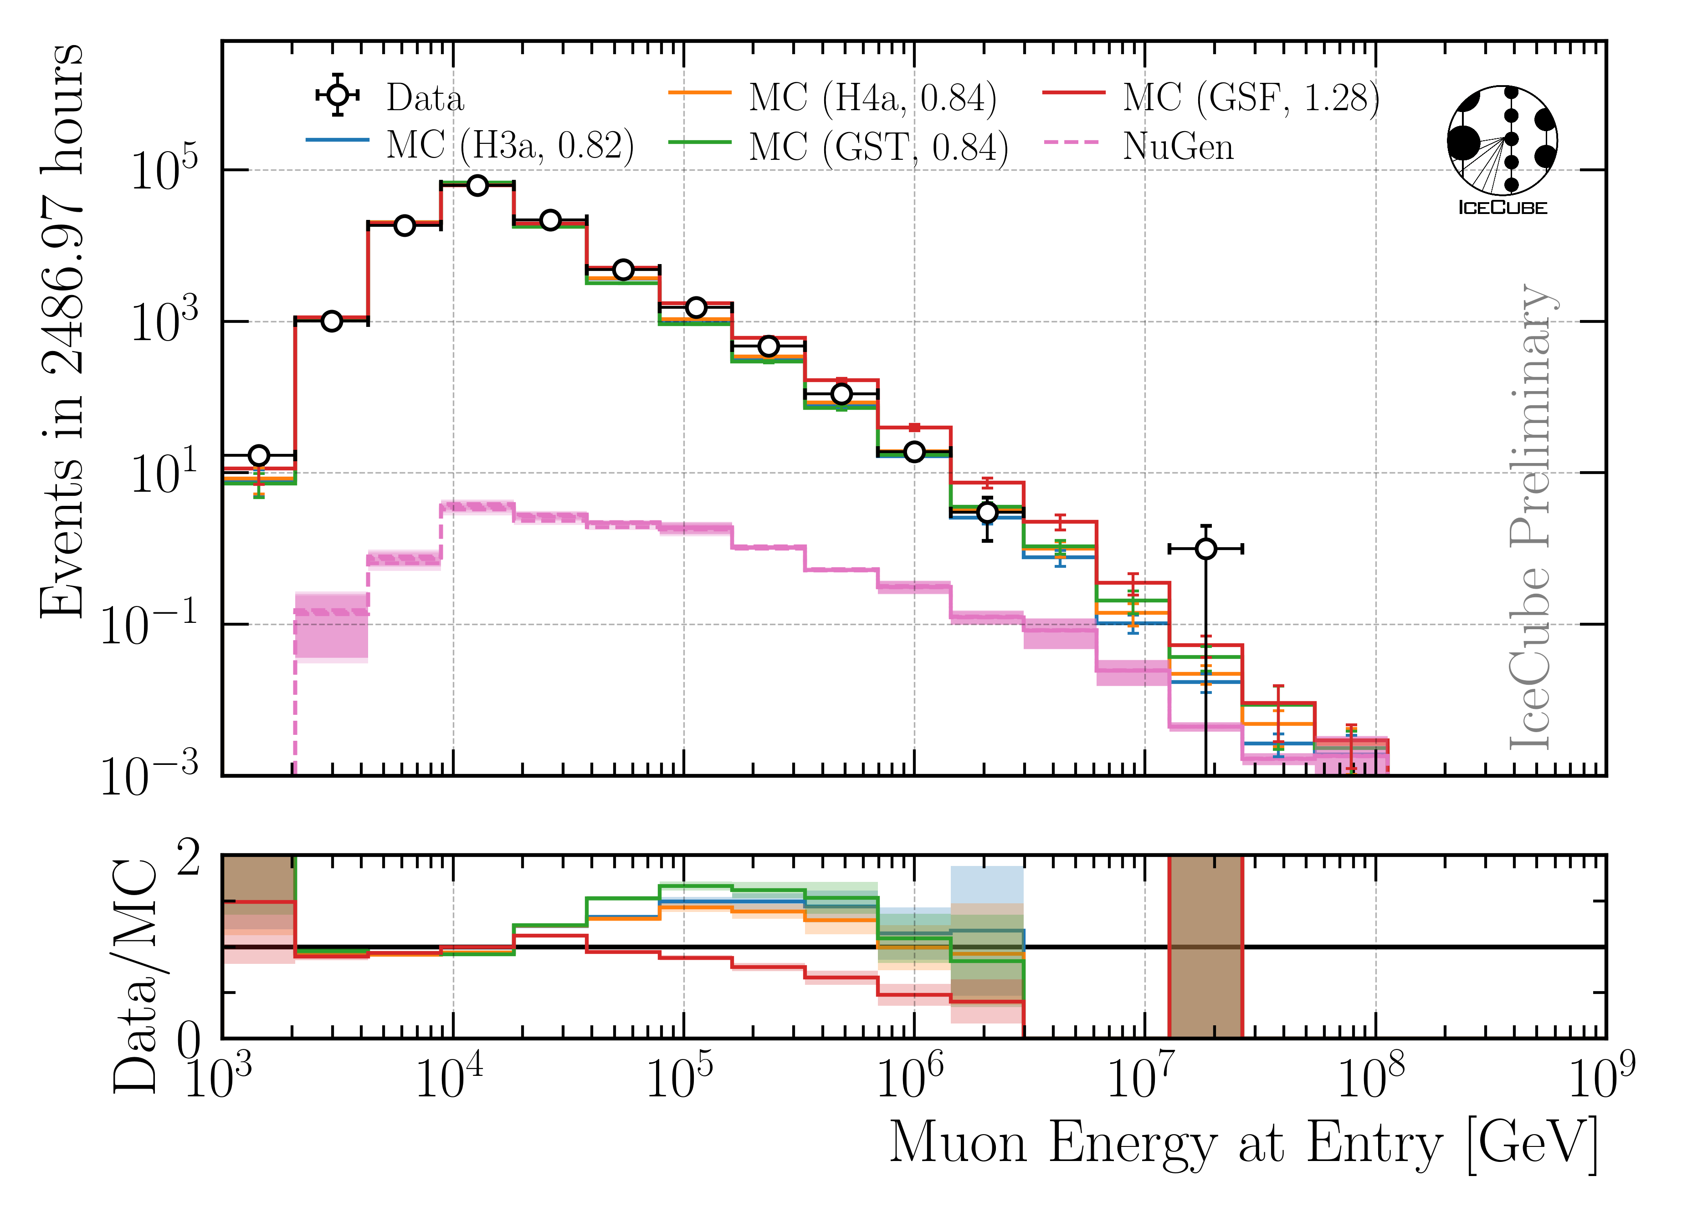
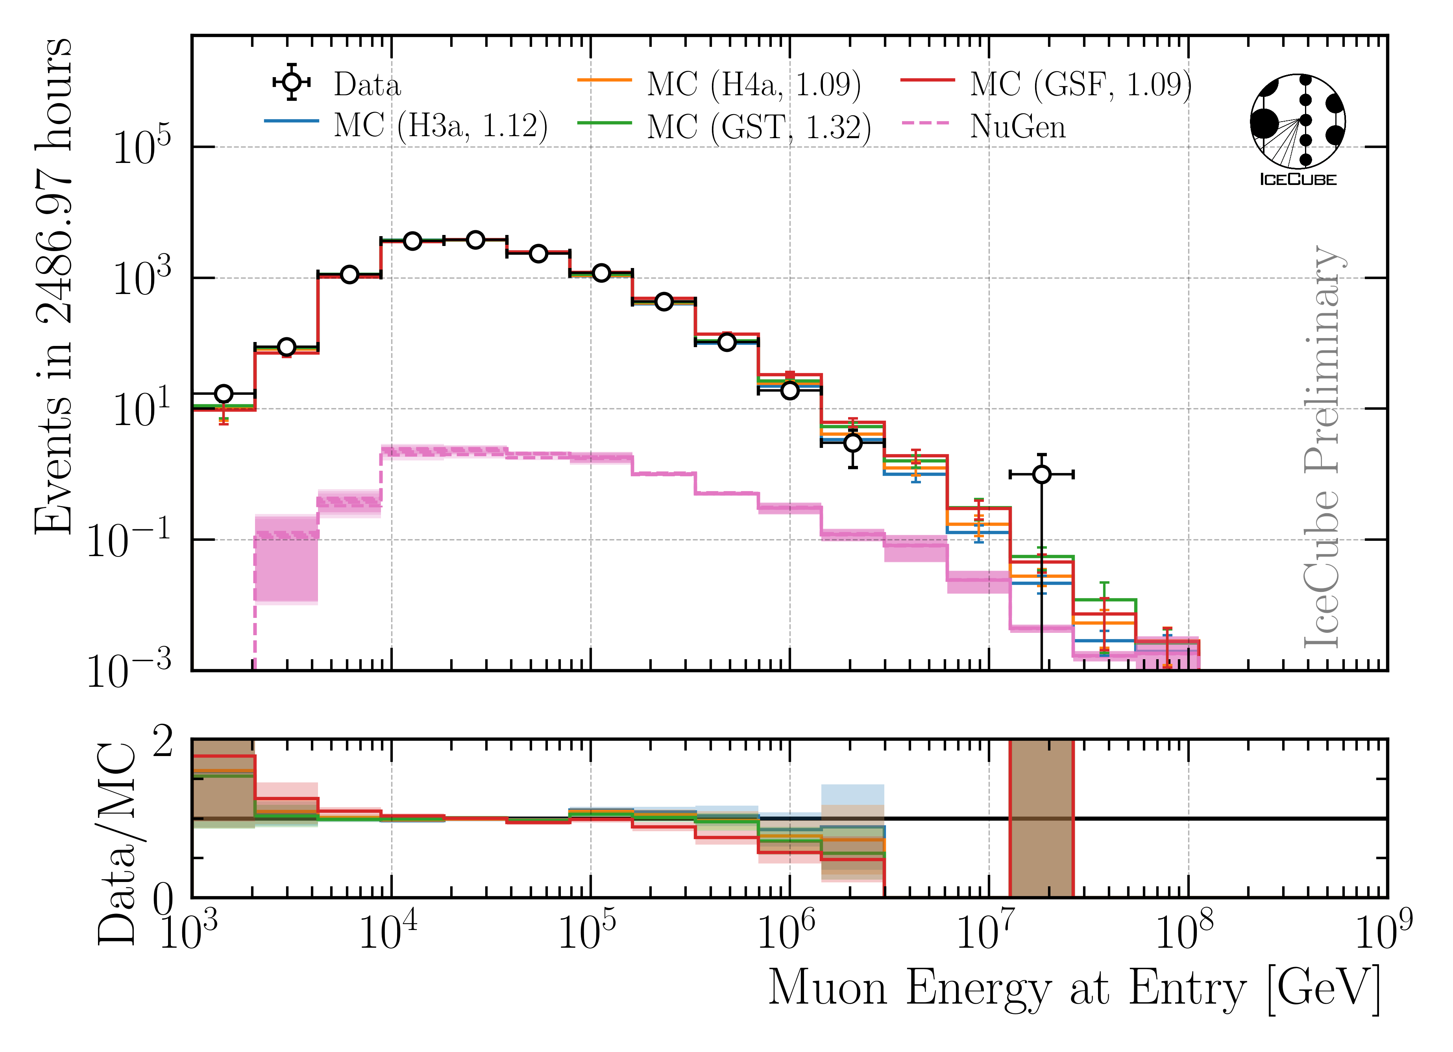
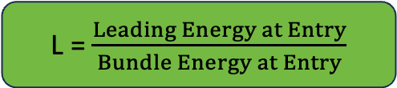
Final Level: Leadingness > 40 %
L = $\frac{Leading Energy at Entry}{Bundle Energy at Entry}$
No leadingness cut
Leadingness > 40 %
Improve Data/MC by leadingness cut

Slide 16
Unfolding

Slide 17
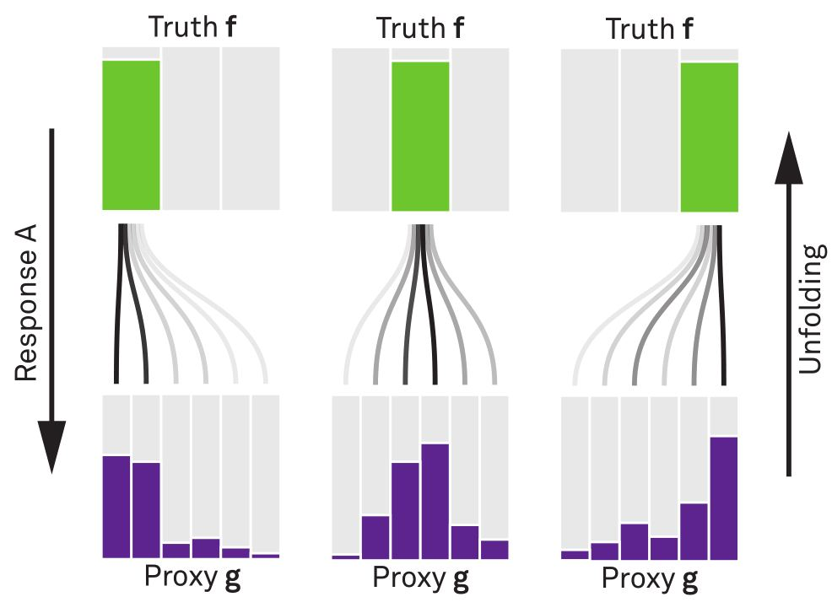


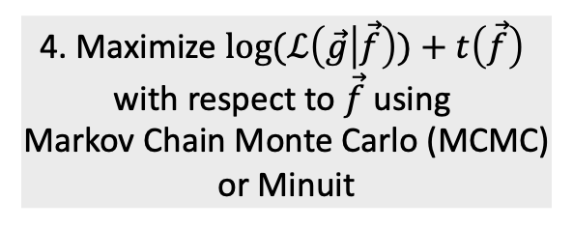
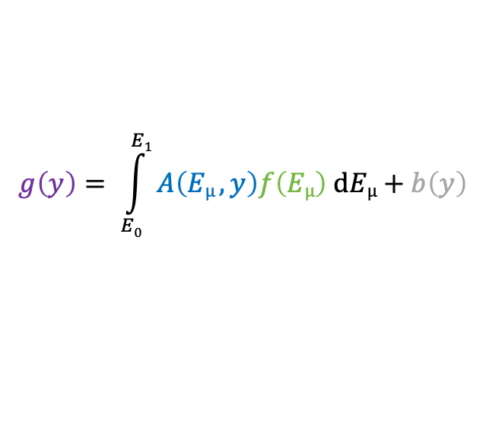
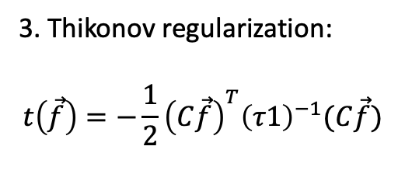
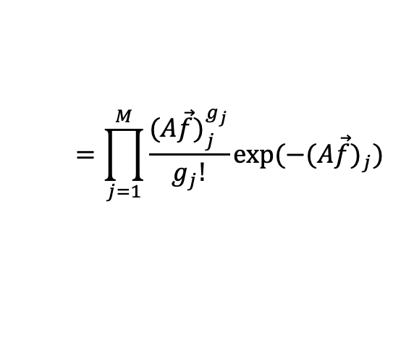
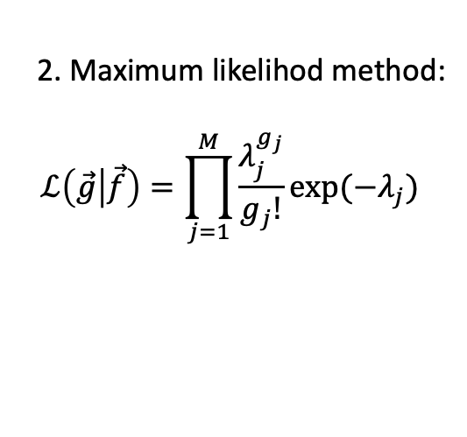
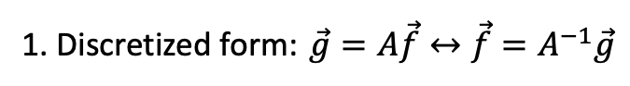
Unfolding in a nutshell
folding
unfolding
detector response
1. Discretized form: $\vec{g}=A\vec{f}↔\vec{f}=A^{−1}\vec{g}$
measured proxy
background
$$g\left(y\right)= \int_{E0}^{E1}{A\left(Eµ , y\right)f\left(Eµ\right) dEµ+b\left(y\right) }$$
2. Maximum likelihod method:
$$ℒ\left(\vec{g} | \vec{f}\right)=\prod_{j=1}^{M}{\frac{λ_{j}^{g_{j}}}{g_{j}!}exp⁡(−λ_{j})}$$
3. Thikonov regularization:
$$t\left(\vec{f}\right)=−\frac{1}{2}{\left(C\vec{f}\right)}^{T}{\left(τ1\right)}^{−1}(C\vec{f})$$
true energy distribution
$$=\prod_{j=1}^{M}{\frac{{(A\vec{f})}_{j}^{g_{j}}}{g_{j}!}exp⁡(−{(A\vec{f})}_{j})}$$
funfolding
by M. Börner
4. Maximize $log⁡(ℒ\left(\vec{g} | \vec{f}\right))+t\left(\vec{f}\right)$
with respect to $\vec{f}$ using
Markov Chain Monte Carlo (MCMC)
or Minuit
Credit: T. Hoinka

Slide 18
Muon Flux Unfolding
Effective area
Systematics
Proxy that correlates with target
Regularization
Unfolding

Slide 19
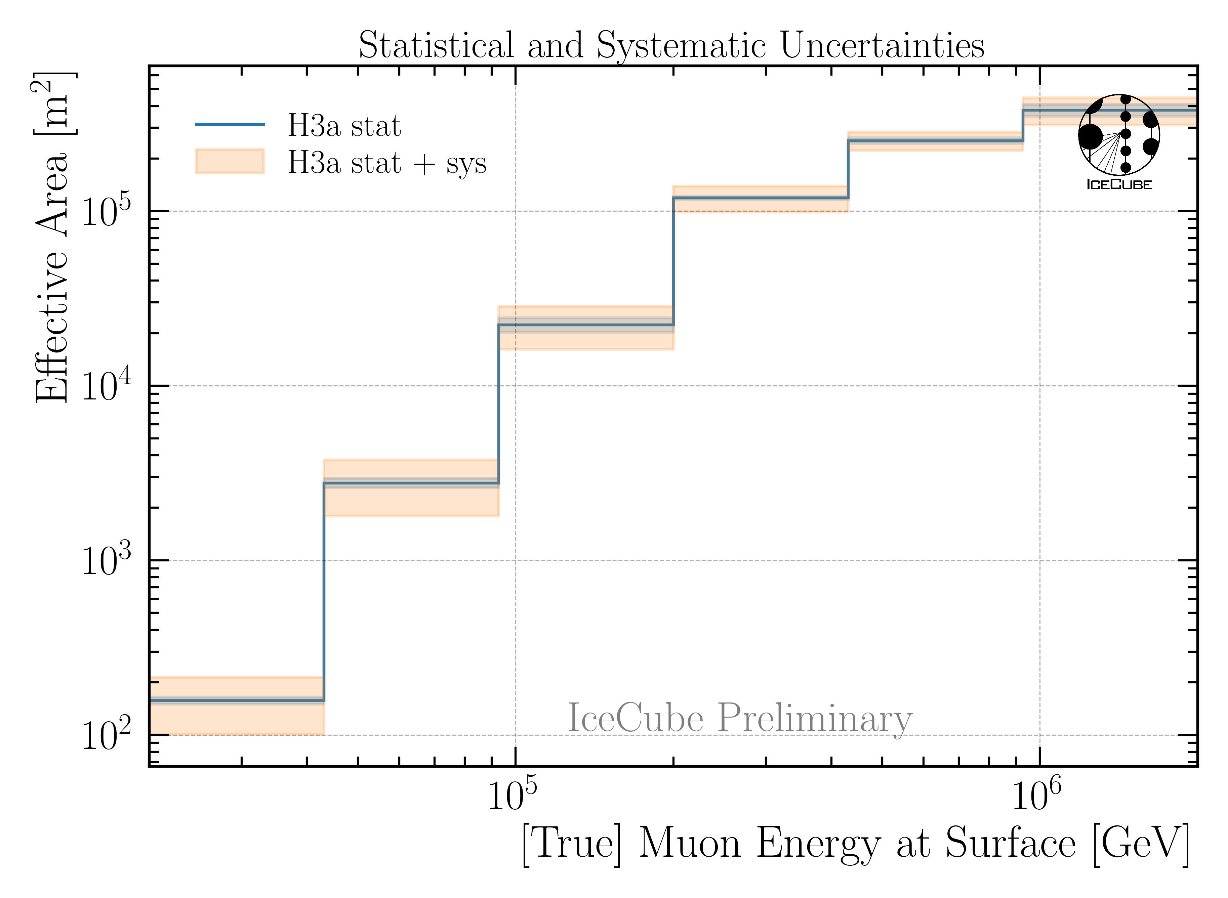
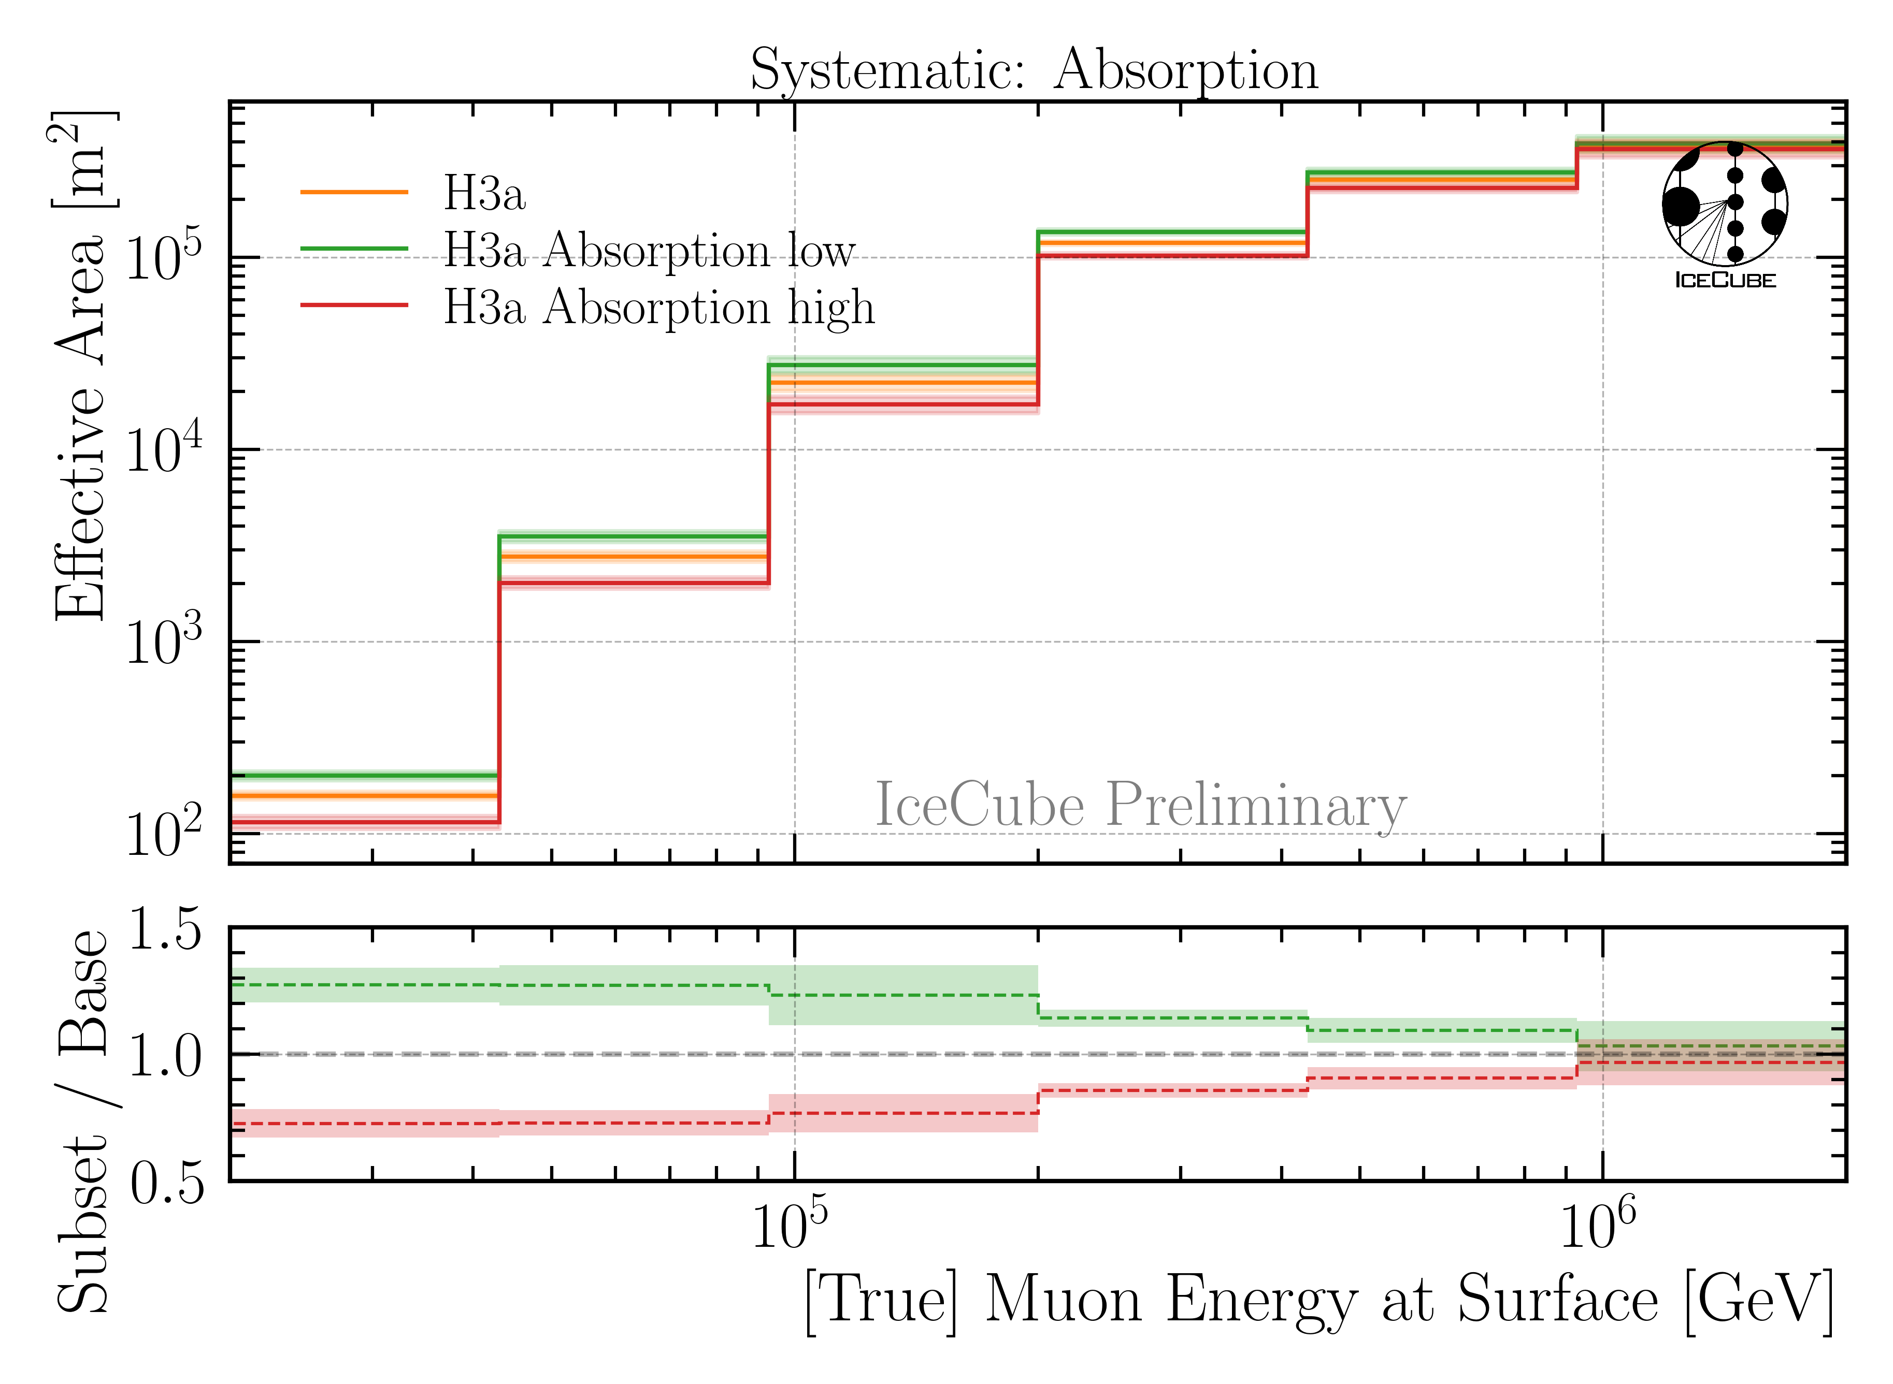
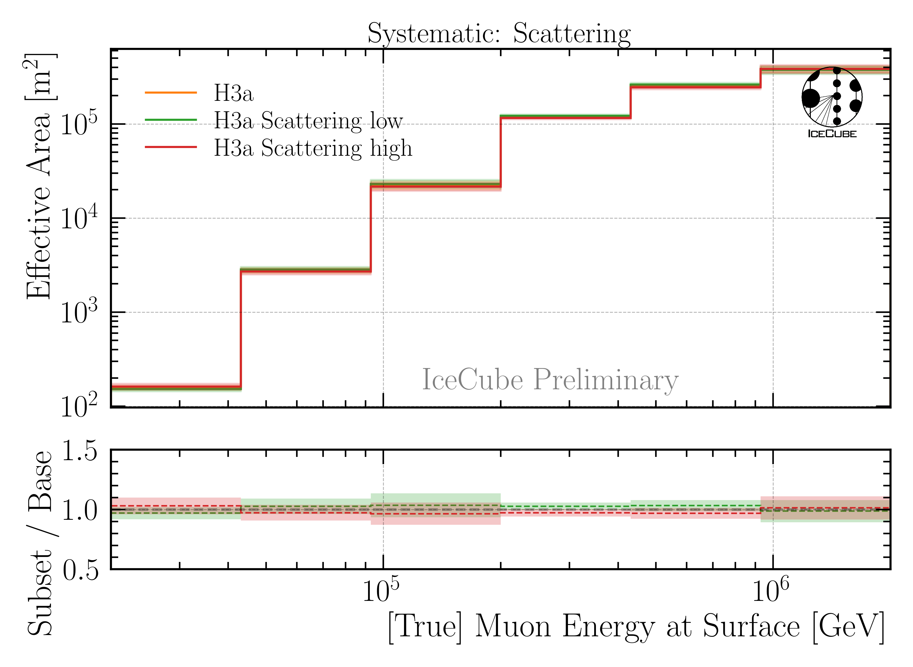
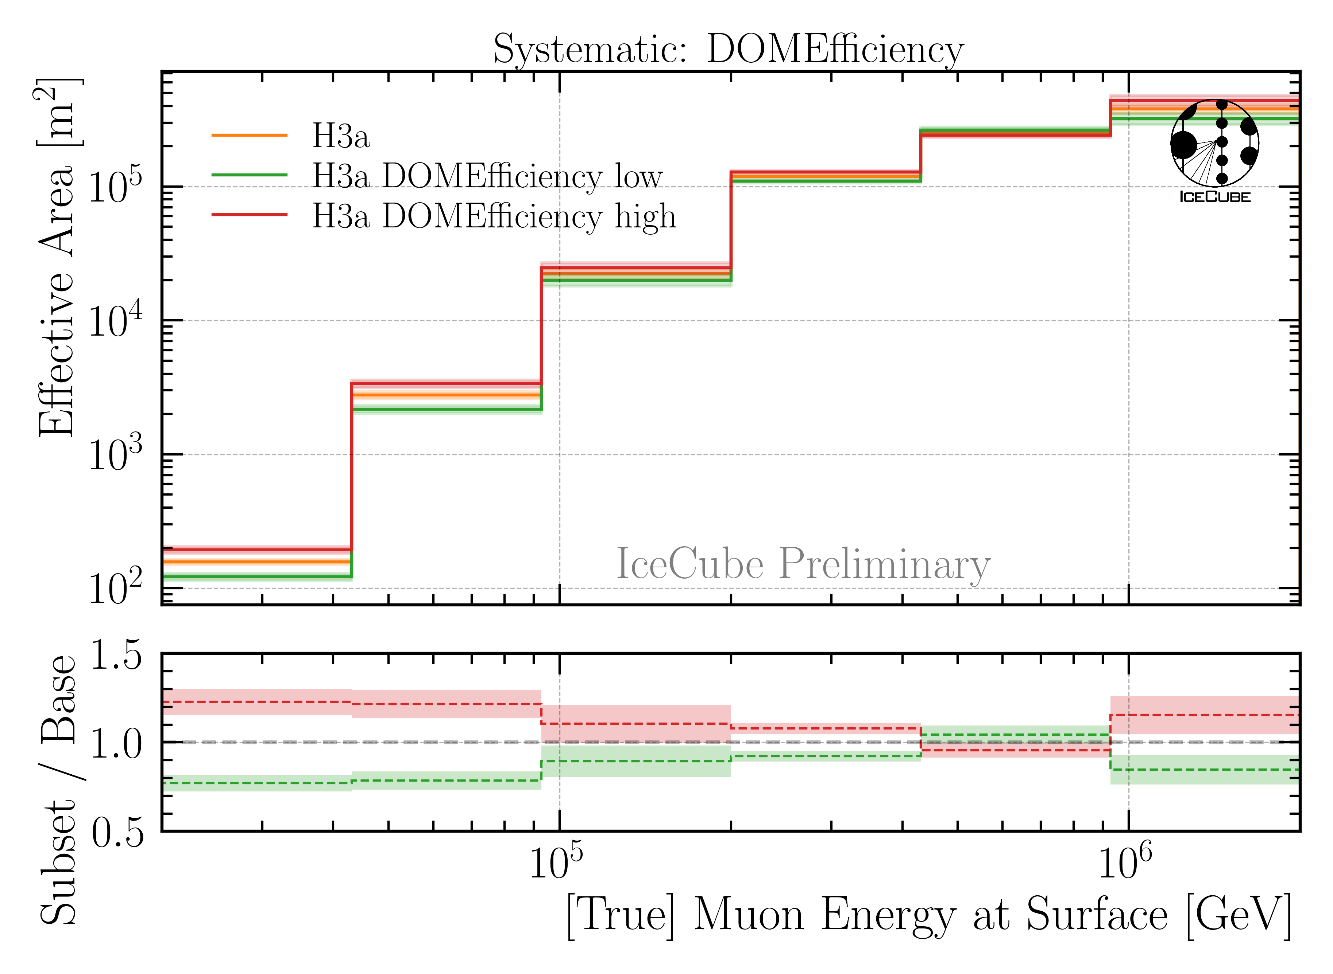
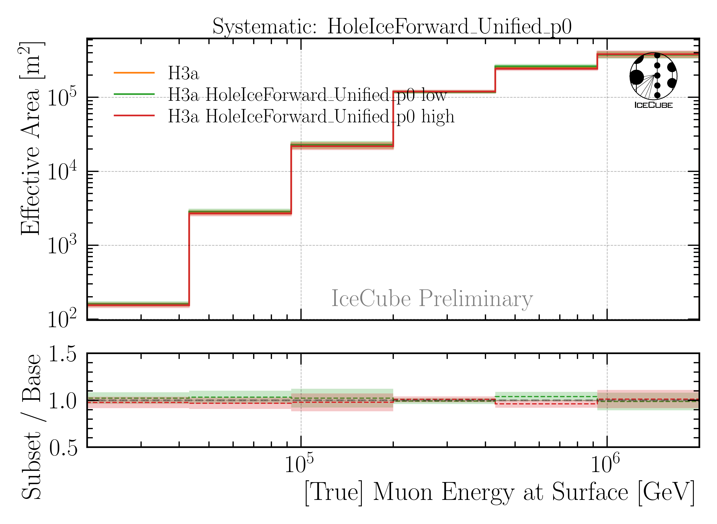
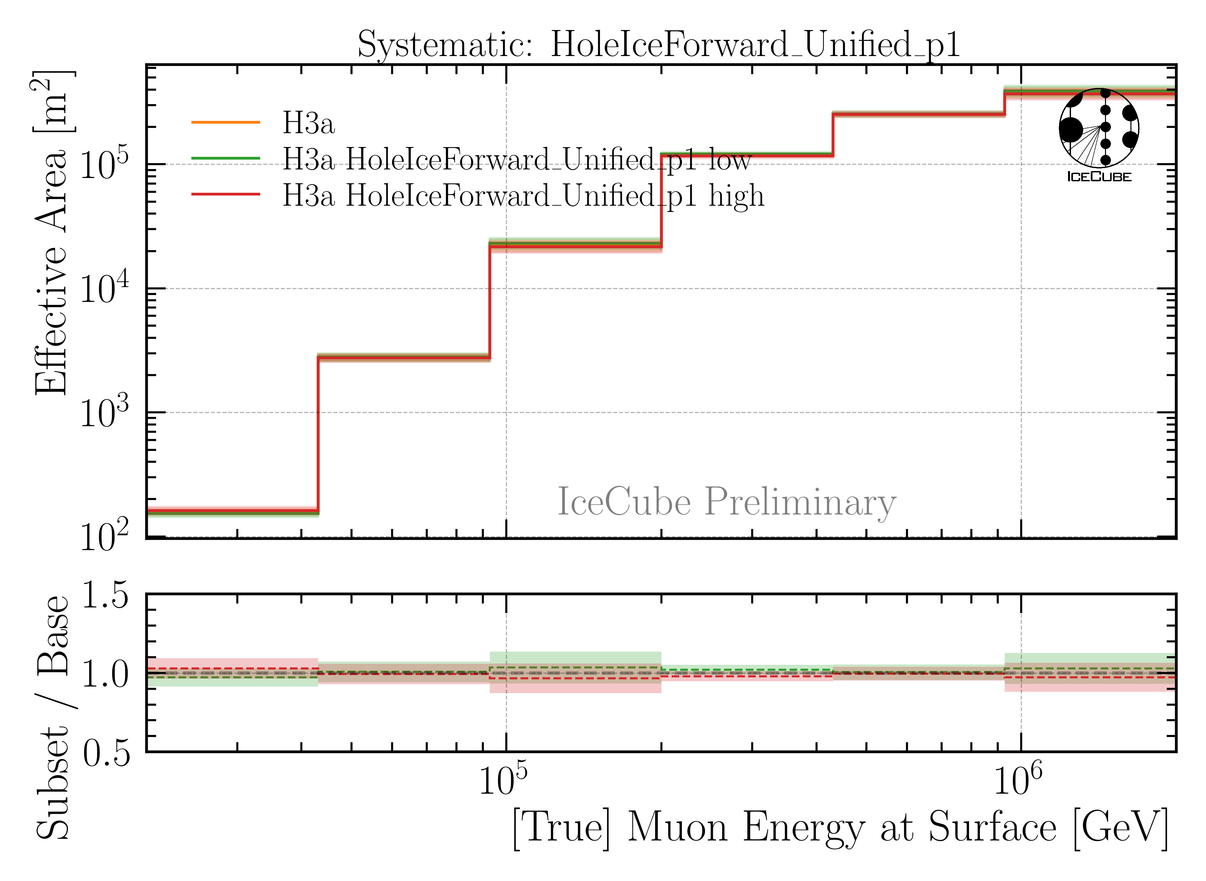
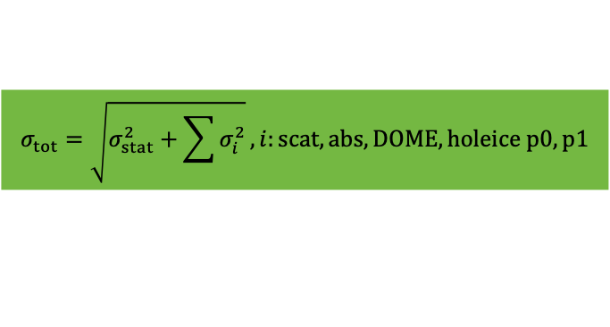
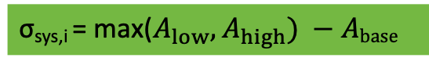
Ice & Detector Systematics
σ_{sys,i} = max($A_{low}, A_{high}) −Abase$
$$σ_{tot}=\sqrt{σ_{stat}^{2}+\sum{σ_{i}^{2}}}, i:scat, abs, DOME, holeice p0, p1$$
Baseline: entire set
Subset: above/below center

Slide 20
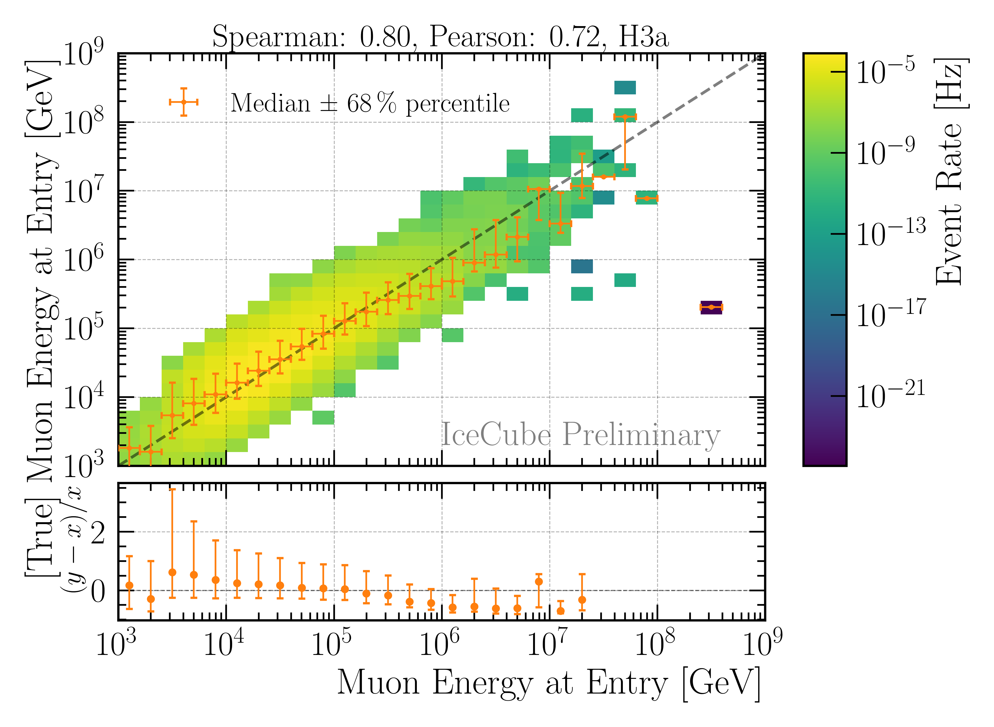
Reconstruction and Data—MC: Leading Muons
Good reconstruction of leading muon energy → proxy
Good data—MC agreement
Global offset → upscale MC by 12%

Slide 21
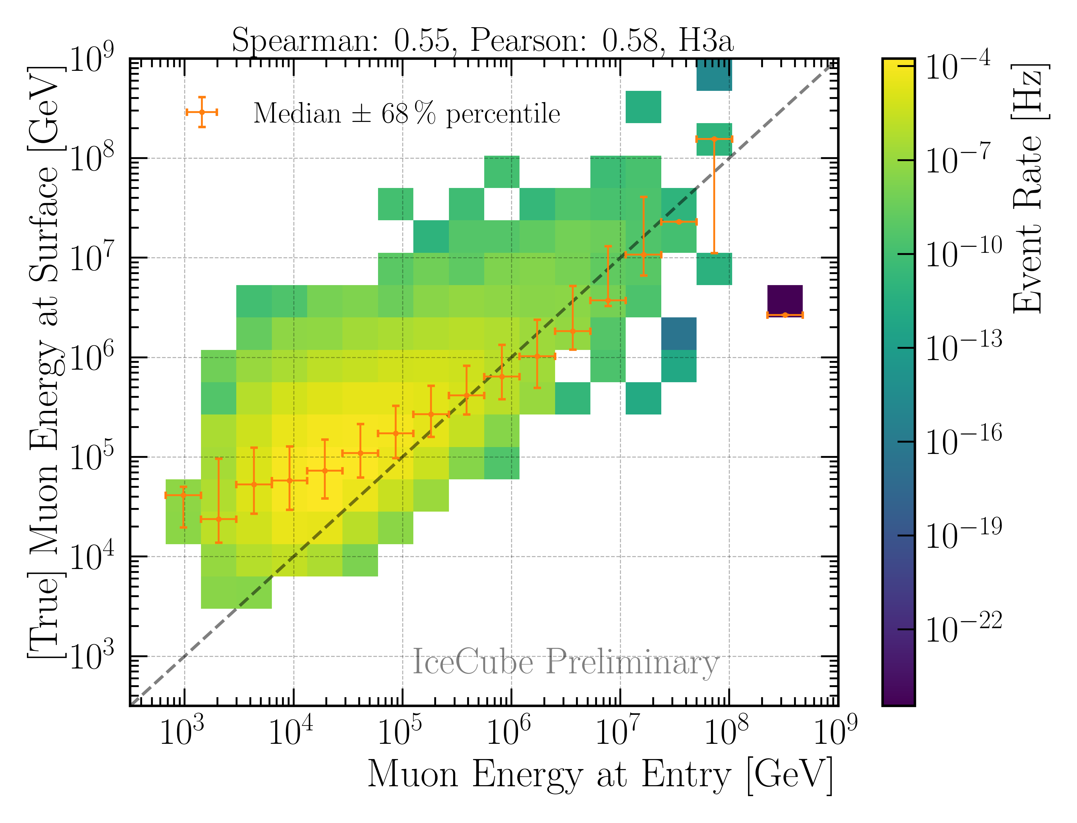
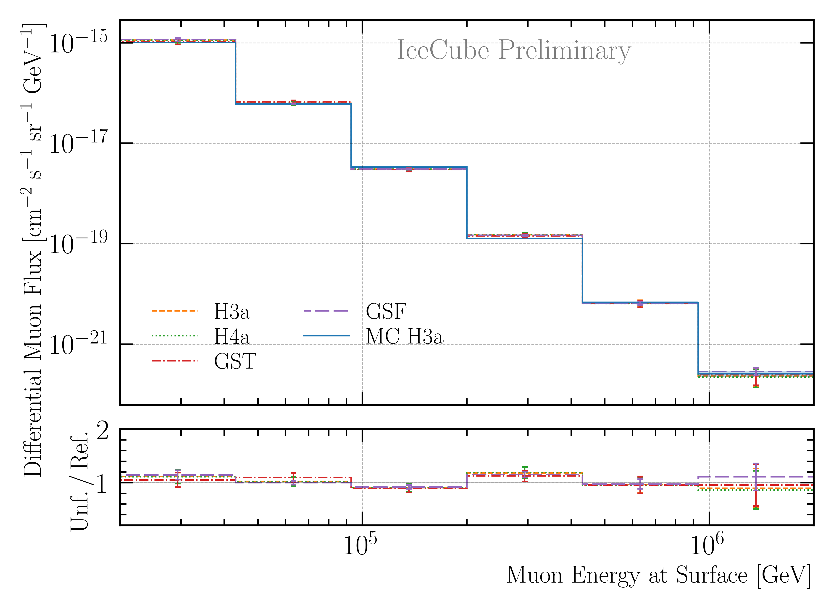
Correlation and Robustness Test: Leading Muons
Build unfolding matrix on H3a, H4a, GST & GSF
Unfold H3a as test set
Results are within uncertainties → robust
Correlation between proxy and target
Burnsample

Slide 22
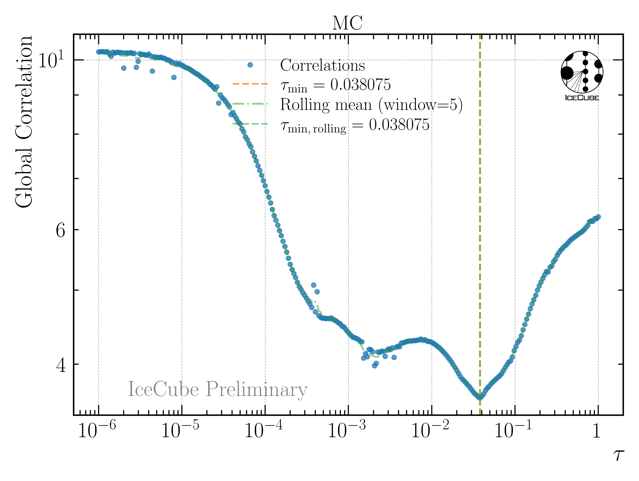
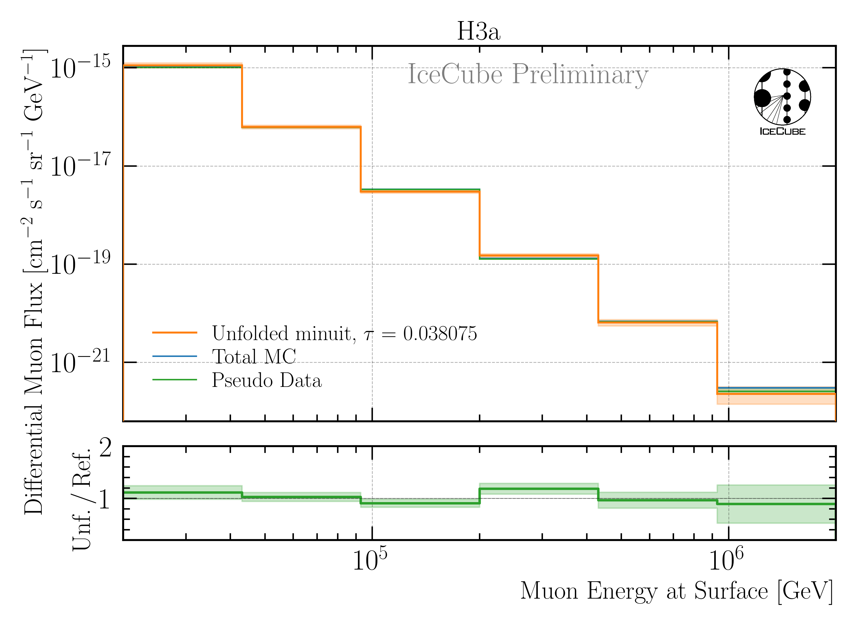
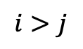
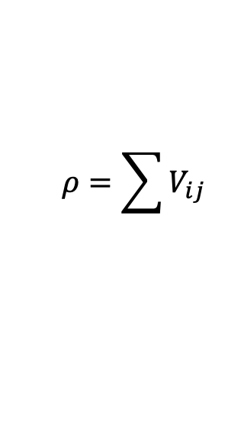
Determine Regularization
Find regularization 𝜏 with minimal bin-to-bin correlation
LLH minimization (unfolding) provides full covariance matrix V
Minimize global correlation
$$ρ=\sum{V_{ij}}$$
$$i>j$$
Unfold MC truth → ratio should be 1
Burnsample

Slide 23
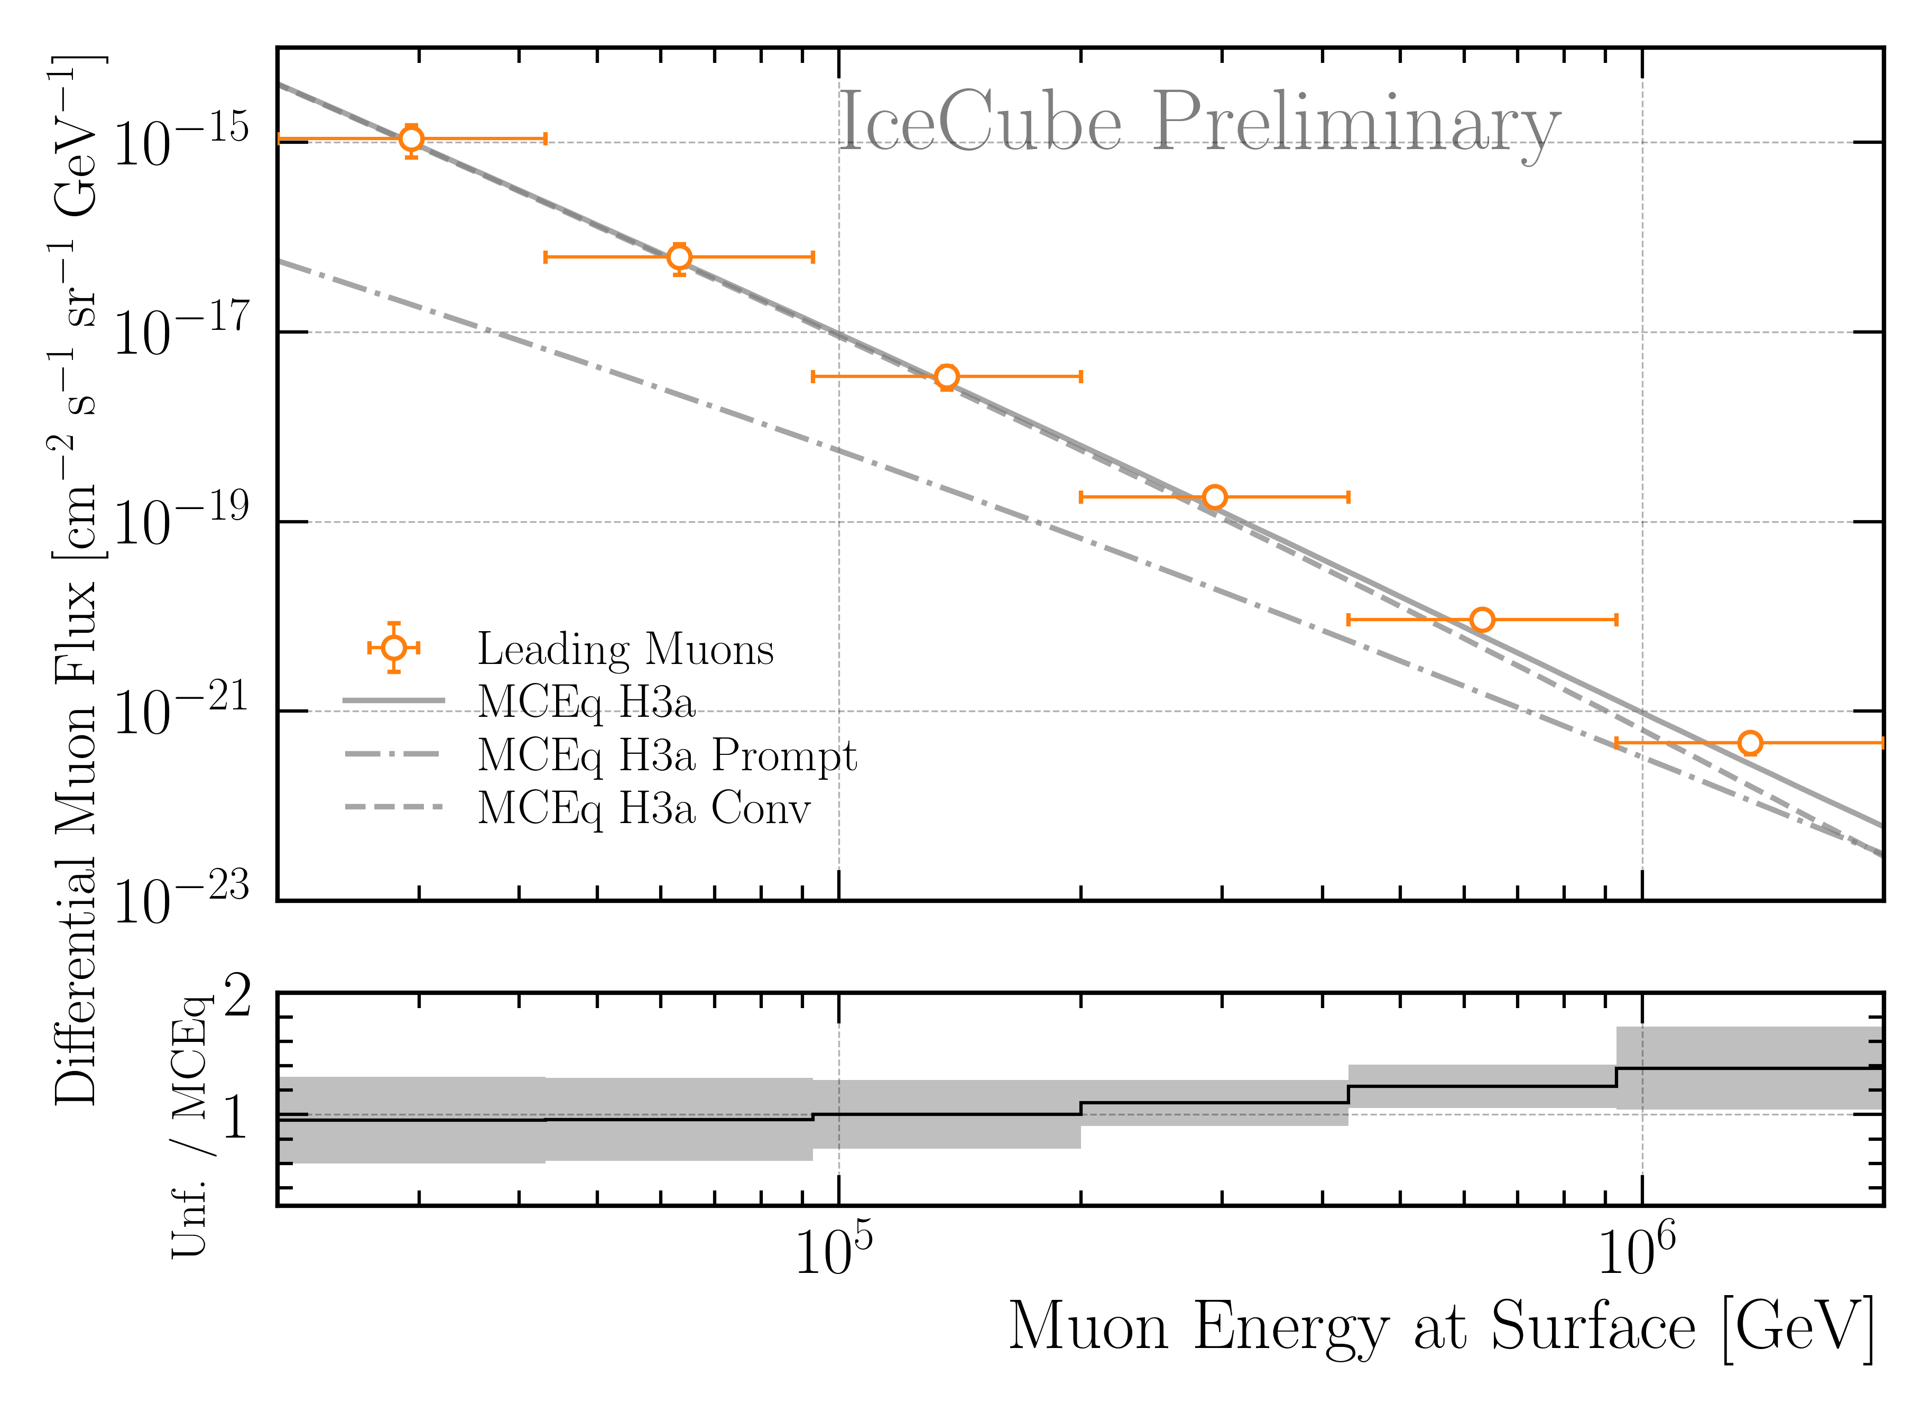
Burnsample Unfolding
Leading muons
2487 h IceCube data
12754 events
Agrees with MCEq

Slide 24
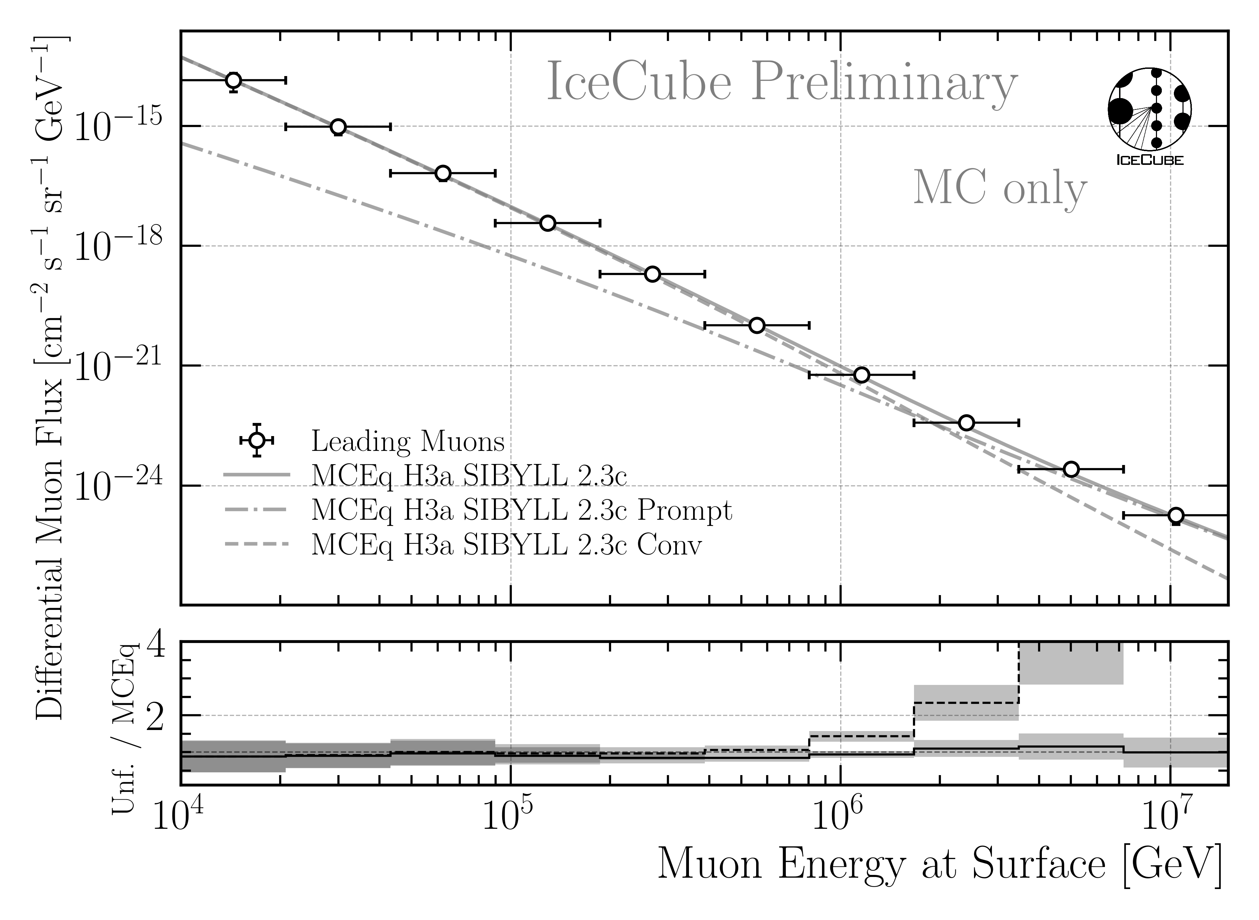
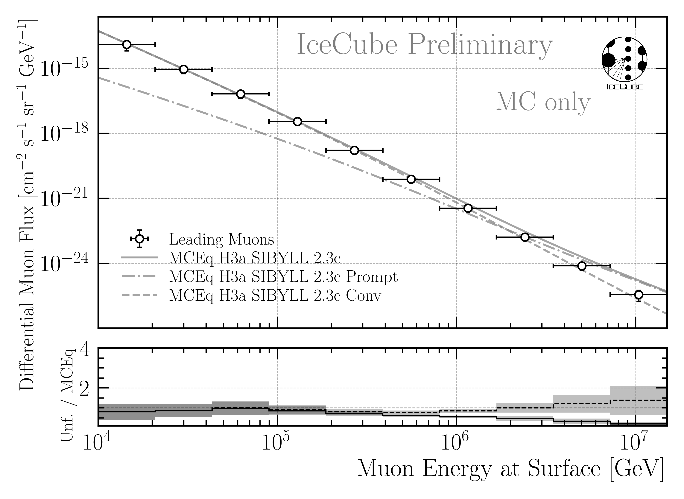
Prediction: 12 Years of IceCube Data Unfolding
Pseudo Sample has prompt
Pseudo Sample has NO prompt
MC only
MC only
Ratio to conv
Ratio to conv
Ratio to total
Unfolding is sensitive to the prompt component
*with systematic uncertainties from effective area

Slide 25
Conclusion & Outlook
New CORSIKA EHIST simulations
Prompt tagging agrees with MCEq
DNN-based reconstructions
Leading muon selection
Burnsample unfolding agrees with MCEq prediction
Outlook
Estimate unfolding uncertainty
Unfold 12 years of data
Future
Forward folding to fit prompt and conv normalization
Thank you for your attention!

Slide 26
Backup

Slide 27
Unblinding Proposal
Unblinding plans
Unfold 12 years of data for IC86 from 2011 to 2022
Determine regularization strength on data
Perform unfolding on data
Post-unblinding checks
Check the data-MC agreement for proxy variable (leading energy)
pre-fit (on the entire Snowstorm dataset)
post-fit (re-weight to fitted systematics)
Divide total dataset in 3 subsets á 4 years to analyze systematic impacts over the years
Unfold spectrum with all 4 CR model matrices
Thank you for your attention!

Slide 28
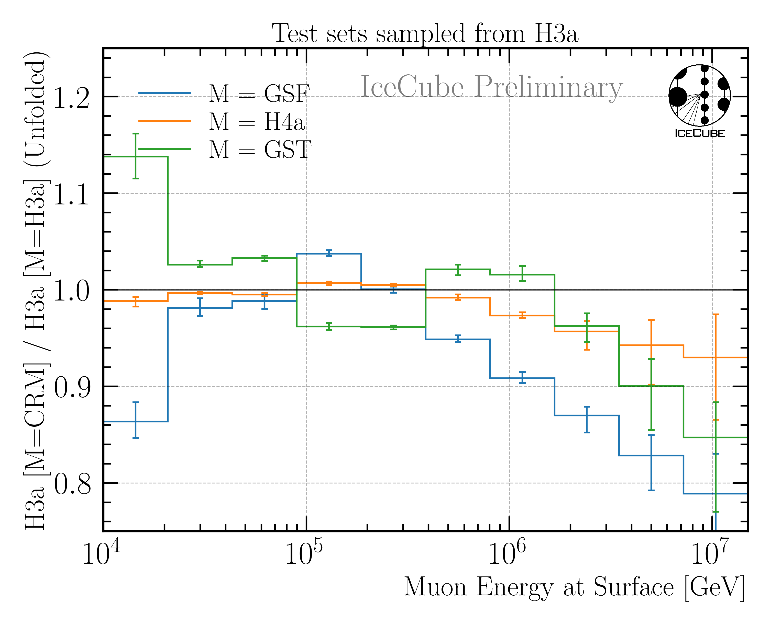
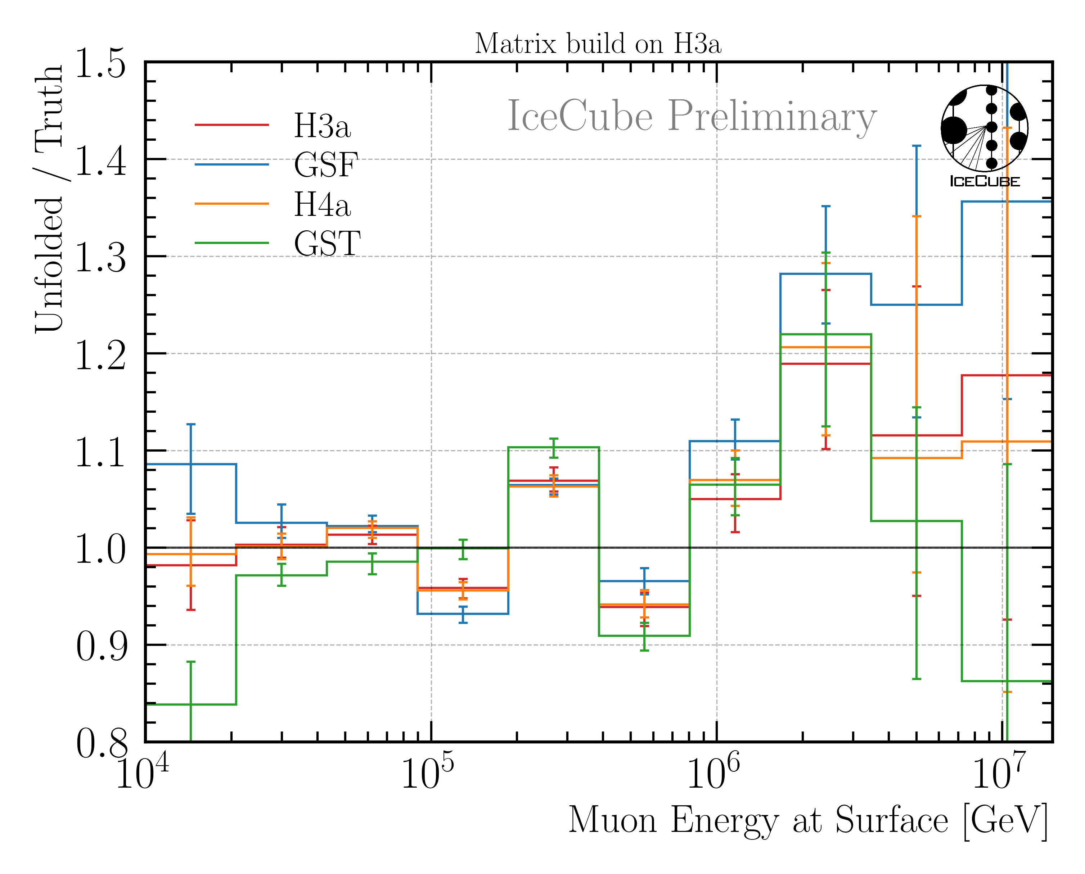
CR Model Impact and Unfolding Bias

Slide 29
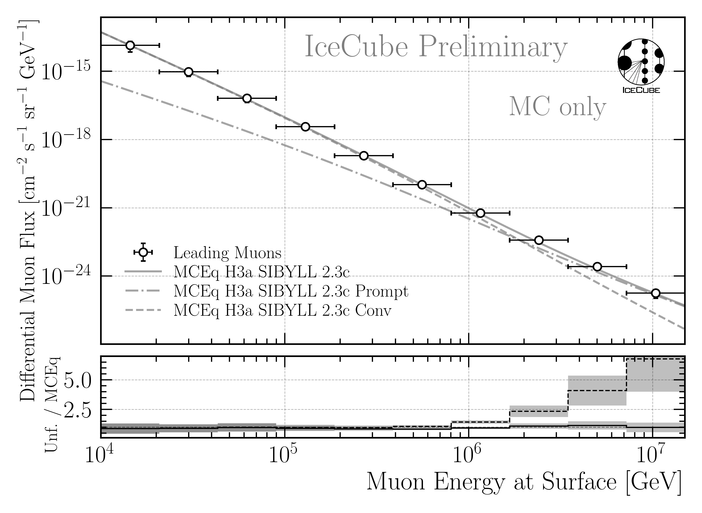

12 Years Prediction: All Uncertainties
minuit + effective area uncertainty
+ CR model uncertainty + unfolding bias

Slide 30
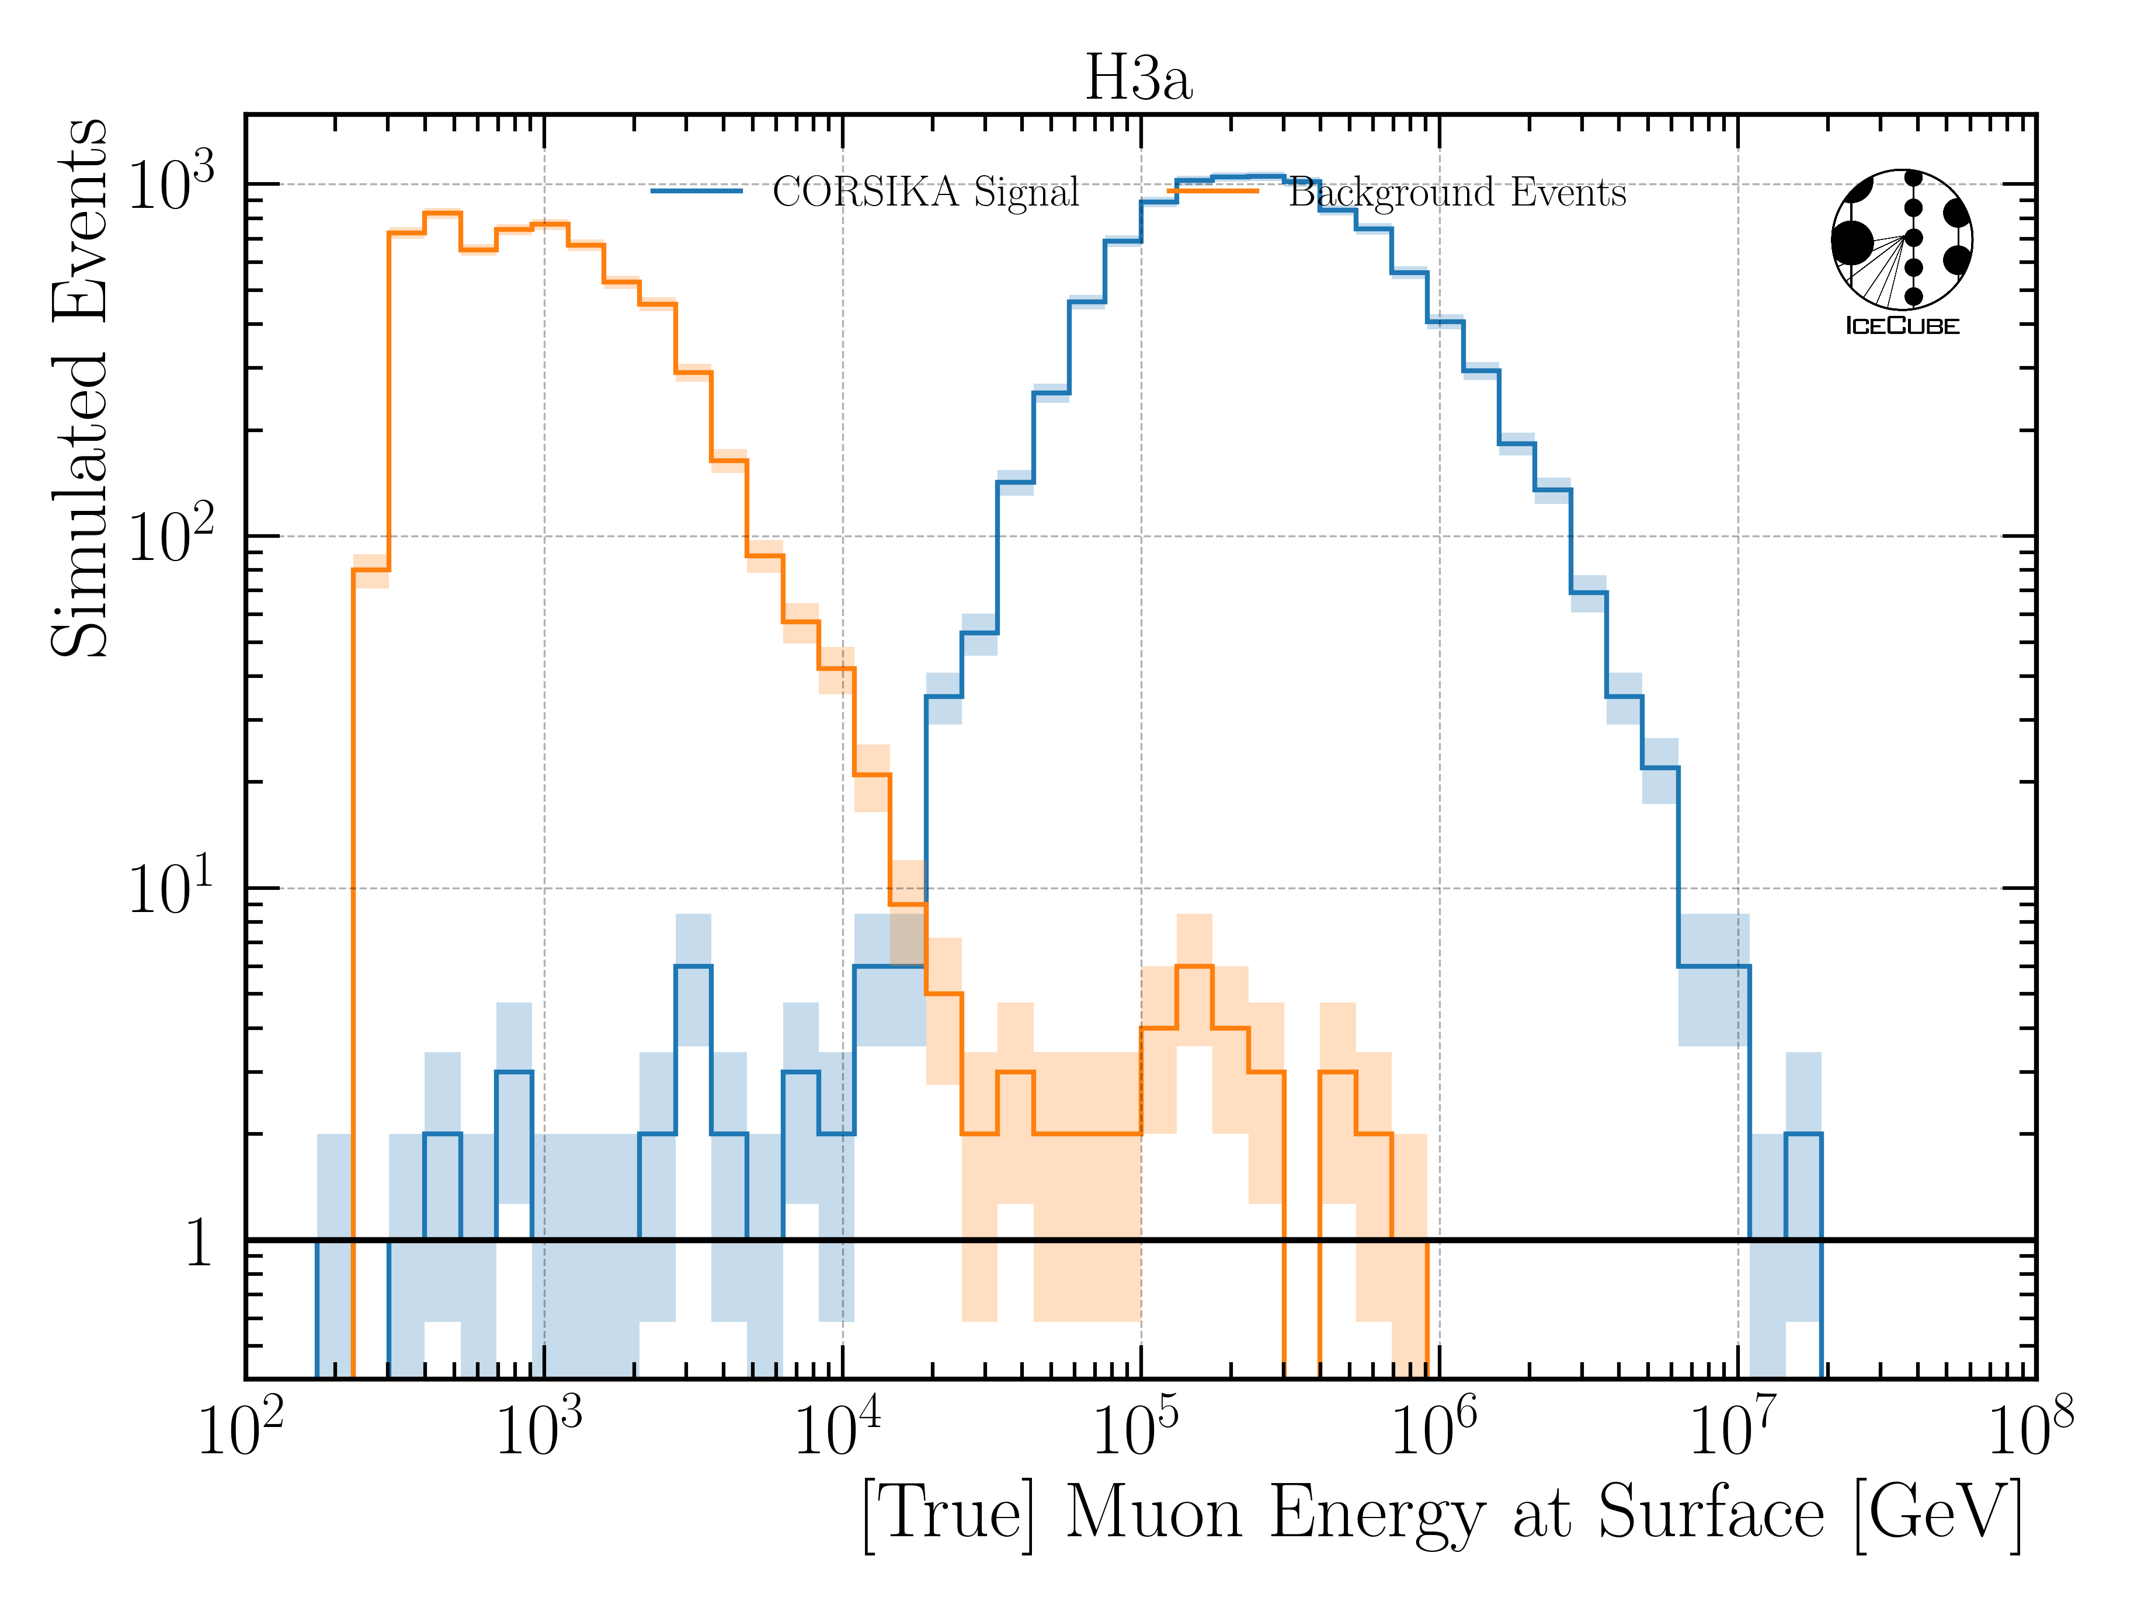
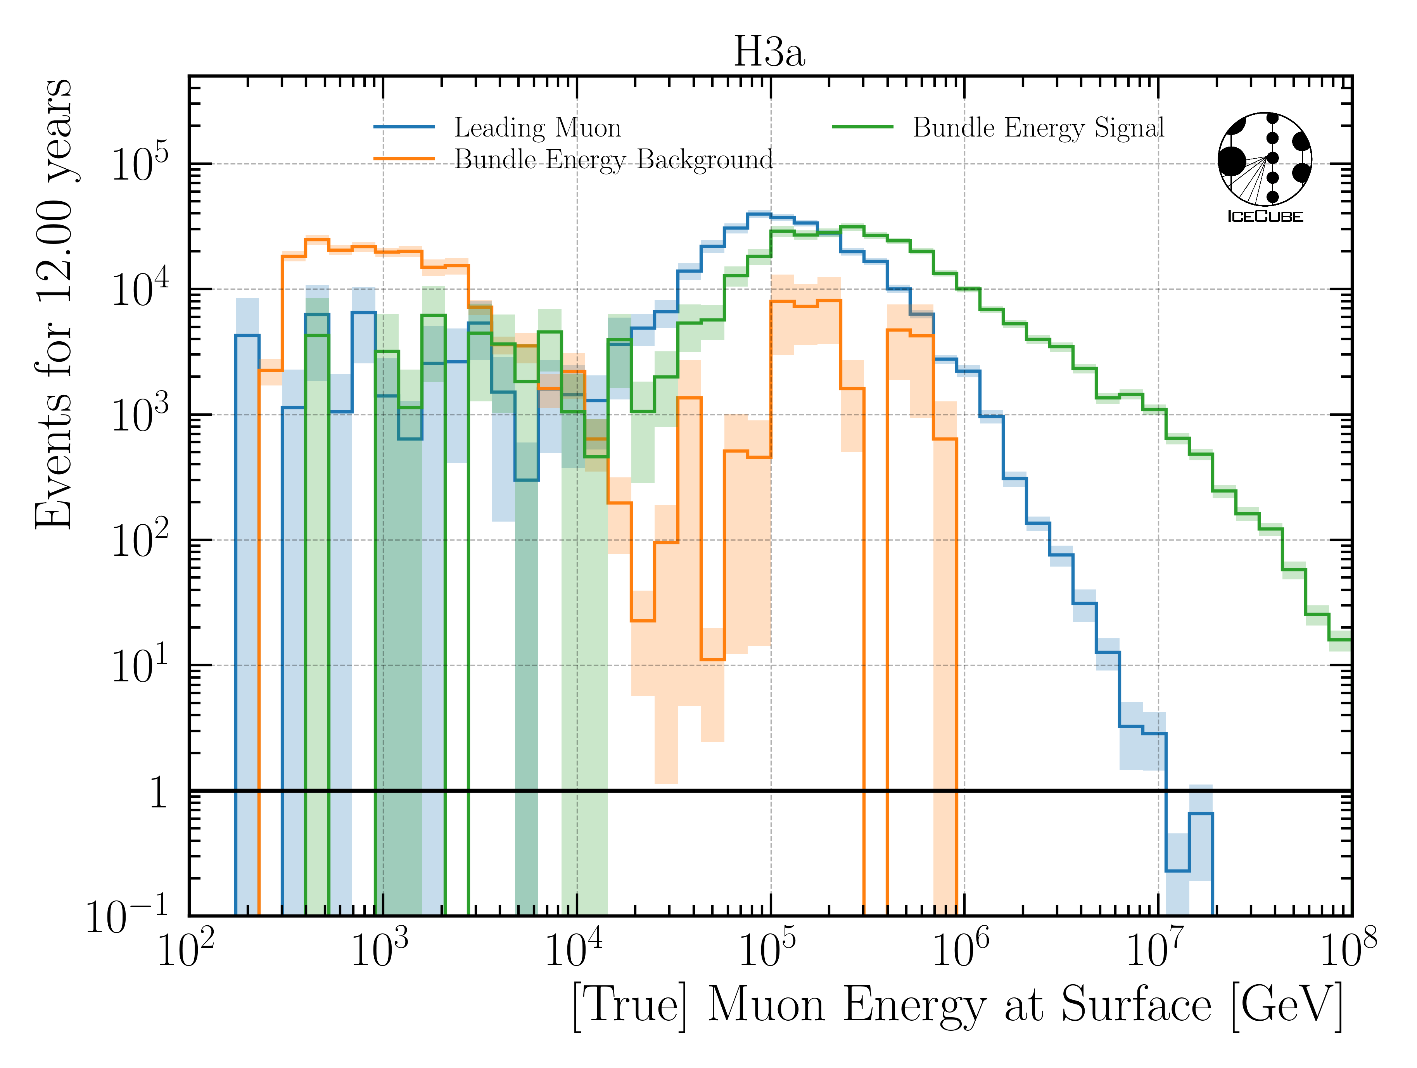
Muon Energy at Surface
simulated
weighted
Leading Muon: most energetic muon in tree
Bundle Energy Signal: sum of all muons of ”signal” primary
Bundle Energy Background: sum of all muons of coincident primaries

Slide 31
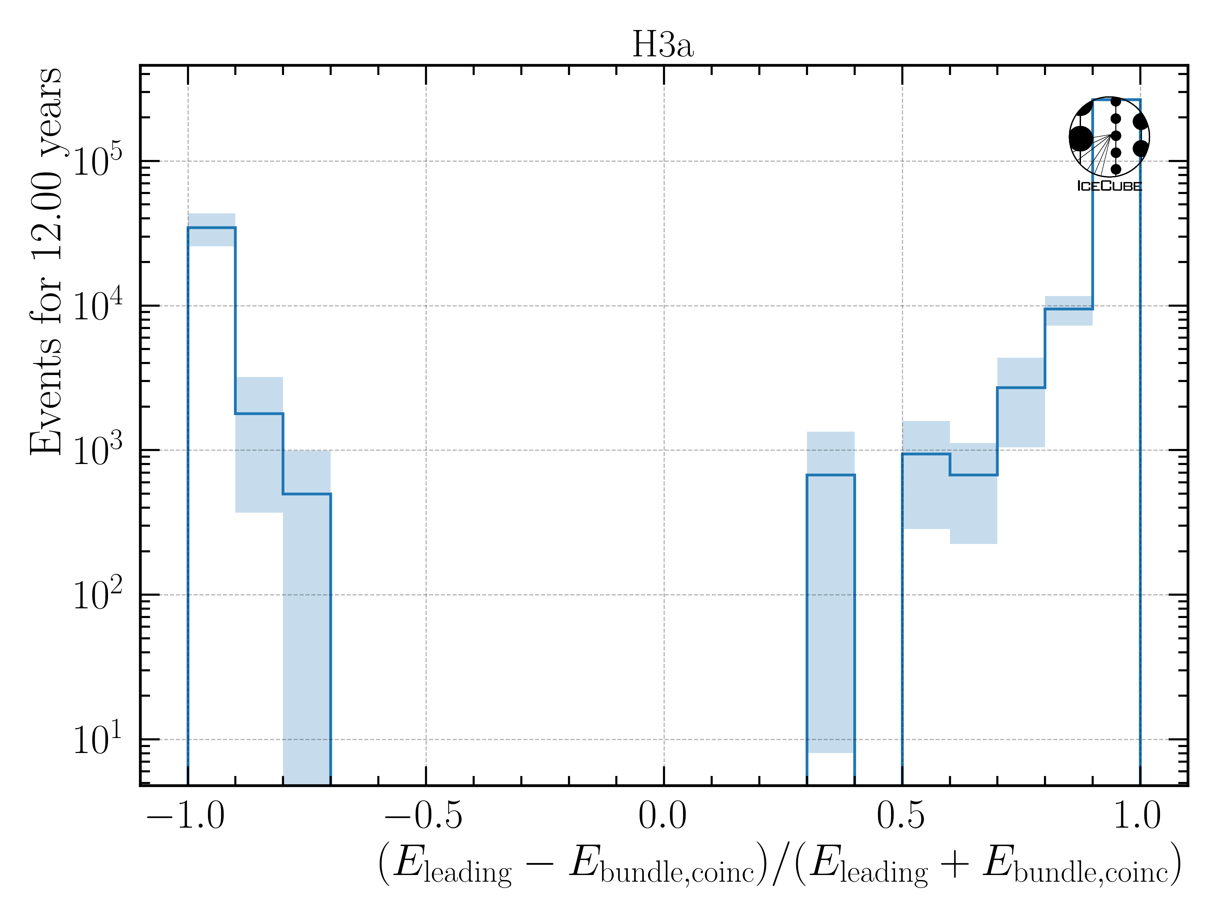

Coincidence: Muons on Event Level
100% Signal
50% Signal, 50% Background
100% Background
above 10 TeV, no background dominated events

Slide 32
Estimate Rates with H3a
Signal rate: 0.84 mHz (total event rate)
Background rate: 0.68 mHz (event rate with at least 1 coincident primary)
Signal rate: 0.74 mHz (leading muon energy at surface > 10 TeV)
Background rate: 0.58 mHz (event rate with at least 1 coincident primary & lead. muon E. > 10 TeV)
Signal rate: 0.74 mHz (leading muon energy at surface > 10 TeV)
Background rate: 0.02 mHz (event rate with at least 1 coincident primary & lead. muon E. > 10 TeV & coincident muon bundle energy at surface hast at least 10% of leading muon energy)
The light of the background events overlaps with the signal → no chance to separate
A 10% bundle energy contribution would shift the measured light up by roughly 10% → within the uncertainties of the energy prediction
Networks have been trained on MC with coincident events → they are able to subtract a little light in case they assume there is a background event, however, this is not quantified

Slide 33





Reconstructions: Coincident Events
no background event
$\frac{\text{bundle} \text{energy} \text{at} \text{surface}}{\text{leading} \text{energy} \text{at} \text{surface}}$ < 0.1
$\frac{\text{bundle} \text{energy} \text{at} \text{surface}}{\text{leading} \text{energy} \text{at} \text{surface}}$ > 0.1
sufficient energy reconstruction for events with background

Slide 34


Estimate Impact of Hadronic Interaction Model
Different CR Models
Different Haronic Models
Not all hadronic models include charm
Impact of HIM smaller than CRM
CRM impact below 3%
Hadronic Model impact is negligible

Slide 35


Reconstruction: EPOS-LHC vs SIBYLL 2.3d [Level 5]
EPOS-LHC
SIBYLL 2.3d
IceTop simulations for proton and iron
23198 and 23201
Primary energy > 1e7

Slide 36




Event Rate to Flux → Effective Area
Unfolding estimates an event rate
Transfer event rate to flux
with solid angle
and effective area

Slide 37

Determine Regularization
Find regularization 𝜏 with minimal bin-to-bin correlation
LLH minimization (unfolding) provides full covariance matrix V
Minimize global correlation
$$ρ=\sum{V_{ij}}$$
$$i>j$$
Unfold MC truth → ratio should be 1
Burnsample

Slide 38

Muon Flux Unfolding
Leading muons
2487 h IceCube data
12754 events
Agrees with MCEq
Stopping muons
47 min IceCube data
32943 events
Below MCEq prediction
*Stopping muon analysis done by Lucas Witthaus

Slide 39


Level 5: Data/MC Quality Cuts
Neutrino weighting:
SPL: n = 1.8, 𝛾 = 2.52
IceCube Collaboration PoS ICRC2023 1064
Good directional reconstruction
Cut: cos(zenith) > 0.2

Slide 40

Final Level cos(zenith)

Slide 41


Bundle Energy Reconstruction
Level 4
Level 5
IceCube Preliminary
IceCube Preliminary

Slide 42


Correlation and Robustness Test: Stopping Muons
Build unfolding matrix on H3a, H4a, GST & GSF
Unfold H3a as test set
Results are within uncertainties → robust
Correlation between proxy and target

Slide 43

Cosmic ray flux
Arxiv: 1903.07713
Notes:
1. Knee: ~3 PeV, before gamma = 2.7, limit of acceleration mechanism for cosmic rays in supernova remnants 2. Knee: ~100 PeV, before gamma = 3.1, heavier elements, like iron, from galactic sources start to reach their maximum acceleration energy → more protons, larger energy in electromagnetic acceleration Ankle: ~1 EeV, flattens out again, transition point between galactic and extra galactic particle origin,

Slide 44




Air shower – 10 TeV
Ralph Engel 2005
“muon bundles”
2211.16970v2
Proton
www.iap.kit.edu/corsika
Iron
Notes:
shower maximum: x_max, slant depth at which the number of particles is the greatest, more energetic and lighter cosmic rays produce deeper/lower x_max, while heavier nuclei have a higher shower maximum
measure number of particles / muons
lateral spread
nitrogen can be excited → fluorescence light emitted
iron produces more muons than proton, because it has 56 nucleons → higher fragmentation → “sub-showers”

Slide 45

Prompt atmospheric muons and neutrinos
10.1103/PhysRevD.100.103018
no unflavored
dominated by pions
dominated by kaons
Combined fit:
handle on pion/kaon ratio
handle on charmed mesons

Slide 46




Muon puzzle and model uncertainties
”muon number”
Expected z
(“muon number”)
2012
2108.08341
1208.1520
Uncertainties at E > 10 PeV
2020
More muons measured than simulated for E > 40 PeV ~ cms 8 TeV
2006.05012

Slide 47
CORSIKA 7 tagging and MCEq comparison
MCEq: tool to numerically solve the cascade equations that describes the evolution of particle densities as they propagate through a gaseous, dense medium
https://github.com/mceq-project/MCEq
GSF weighting
GSF weighting
Good agreement in total prompt and conv muon flux
D⁰ and D_{s} are swapped here but this is fixed in MCEq
mention panama

Slide 48

Machine Learning Reconstructions
10.1088/1748-0221/16/07/P07041
Credit: IceCube
Convolutional Neural Network
Inputs
c_{total}: Total charge
Sum of charge
t_{first}: Relative time of first pulse
Relative to total time offset
t_{std}: Standard deviation of first pulse
Charge weighted standard deviation of pulse times
Outputs
Direction
Stopping point
Entry point
Energy at entry/surface
…
Credit: IceCube

Slide 49
Level5: quality cuts
containment cuts | > | <
length in detector | 1000 m | 2000 m
entry pos x, y | -750 m | 750 m
entry pos z | -500 m | 750 m
center pos x, y | -550 m | 550 m
center pos z | -650 m | 650 m
uncertainty cuts | <
bundle energy at entry | 0.9 log10(GeV)
bundle energy at surface | 2.0 log10(GeV)
zenith | 0.1 rad
azimuth | 0.2 rad
entry pos x , y, z | 42 m
center pos x, y, z | 50 m
entry pos time | 200 ns
center pos time | 600 ns
length in detector | 160 m
length | 2000 m
neutrino cuts | > | <
cos(zenith) | 0.2
length | 5000 m | 15000 m

Slide 50

The Muon Puzzle
”muon number”
Arxiv: 2108.08341

Slide 51

Possible Solutions
Slide taken from Hans Dembinski

Slide 52


MCEq vs CORSIKA

Slide 53


MC Statistics: Fine binning

Slide 54


MC Statistics: Unfolding binning

